Slide 1
SLIDE DECK 2: Municipalities

Slide 2
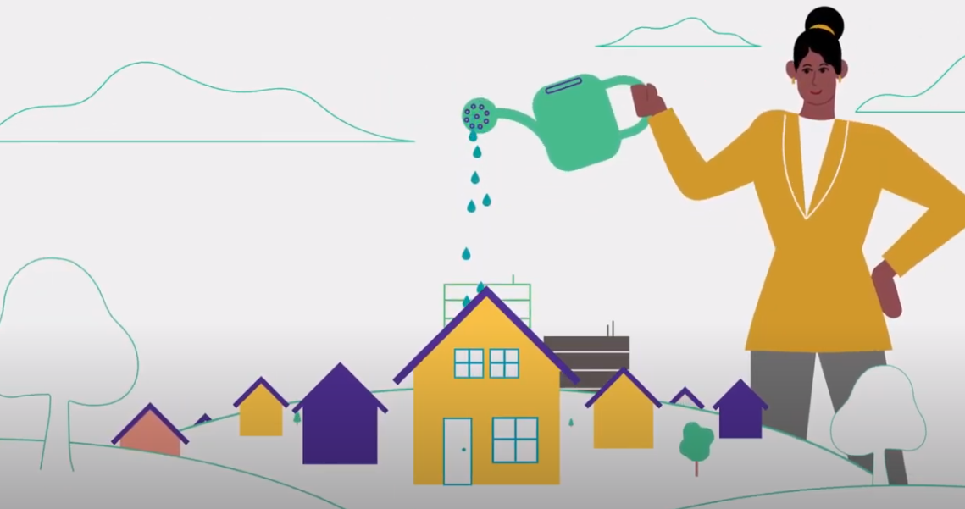
MUNICIPALITIES
Municipalities, also known as municipal governments, are responsible for providing essential local services and managing the growth and well-being of their community.

Slide 3
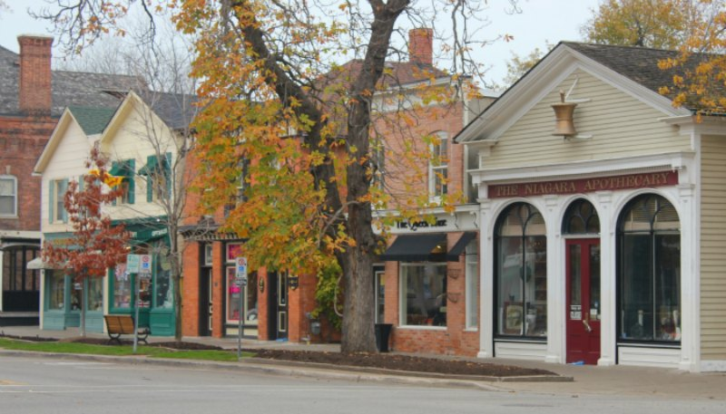
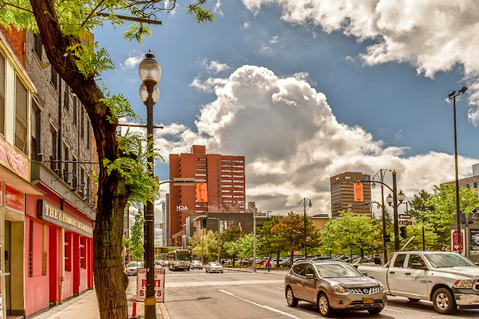
MUNICIPALITIES IN ONTARIO
There are 444 municipalities in Ontario
A municipality can be called a city, town, village, township, county or region.
The Municipal Act, 2001 is a law in Ontario that allows municipalities to make rules, called bylaws, and make decisions for their community. This means they have the power to take care of local issues and services for the people who live there.

Slide 4
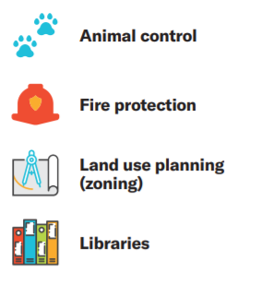
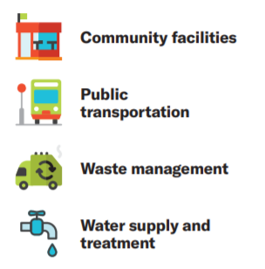
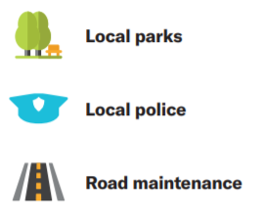
PROGRAMS AND SERVICES
Health and Human Services

Slide 5
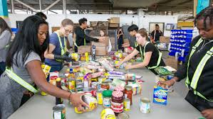
THE ROLE OF MUNICIPALITIES
In addition to delivering services, municipalities work to address issues in the community.
Municipalities might collaborate with key partners to tackle major issues like poverty reduction and access to food.
For example, municipalities may partner with food banks and other organizations to promote initiatives like community kitchens and dinners, school breakfast and healthy snack programs, community gardens.

Slide 6
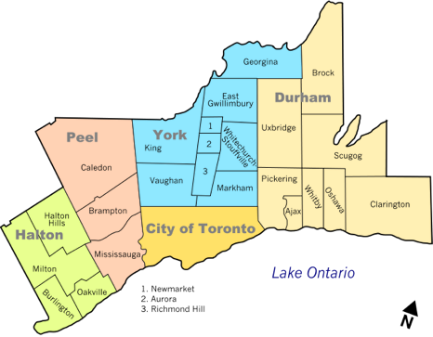
KEY FEATURES OF MUNICIPALITIES
A specific geographic area with boundaries
2) The power to tax
3) An elected council

Slide 7
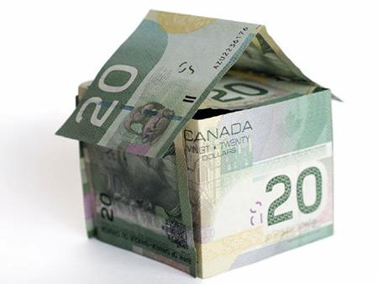
PROPERTY TAXES
If you own property, you will pay a certain percentage of its value in taxes every year to your municipality. These are called property taxes.
The money collected from property taxes helps pay for local services and some goes to the education system.

Slide 8
TYPES OF MUNICIPALITIES
The types of services delivered by a municipality may also depend on whether the municipality is part of a two-tier system.
A single-tier municipality is a city, town, or community that takes care of all its own services. It doesn’t share responsibilities with another level of local/municipal government.
A lower-tier municipality is part of a bigger group of communities called a region or county. It handles some local services, like parks, libraries, and community centers, for its specific area..
An upper-tier municipality is the region or county that oversees several lower-tier municipalities. It handles services that affect the whole region, like major roads, public health, and police services.

Slide 9
SINGLE-TIER MUNICIPALITIES
There are 173 single-tier municipalities in Ontario.
Some examples include:

Slide 10
UPPER-TIER AND LOWER-TIER MUNICIPALITIES
There are 241 lower-tier municipalities and 30 upper-tier municipalities.
For example, the Region of Peel is an upper-tier municipality for three lower-tier municipalities (Mississauga, Caledon, Brampton).

Slide 11
LOCAL COUNCILS
Each local council (single-tier or upper-tier) is made up of a head of council (mayor or reeve) and council members (councillor or alderman)..
The head of council and some councillor members are elected at-large, which means by all voters in the municipality.
Sometimes council members are elected by a ward system (where the municipality is broken down into smaller sections).
Position | Title | Election
Head of Council | Mayor | At-large
 | Reeve | At-large
Council member | Councillor | By-ward or at-large
 | Alderman | By-ward or at-large

Slide 12
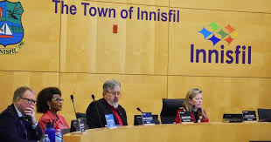
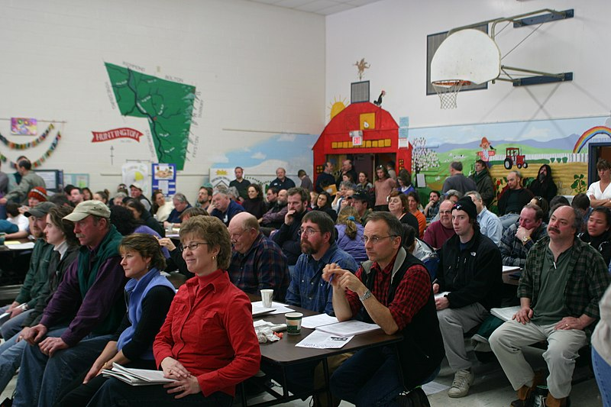
ROLE OF COUNCIL
Council members govern their municipality through the following activities:
Listening to the concerns and ideas of community members
Attending meetings
Reviewing reports from municipal officials
Creating, debating and voting on by-laws (rules) they believe will improve their municipality.

Slide 13
DISCUSSION
Can you identify any problems or challenges in our community?
Do you see any opportunities for improvement?
What actions could be taken to make a positive change in our community?
How can you be an active community member?

