Slide 1
The Democratic Engagement Solutions Bank
Shared knowledge, stronger democracy

Slide 2
1
Municipal democracy today
2
Seven ways we can improve
3
Shared knowledge
4
How it works
5
Moving forward

Slide 3
Municipal democracy today
Setting the context

Slide 4
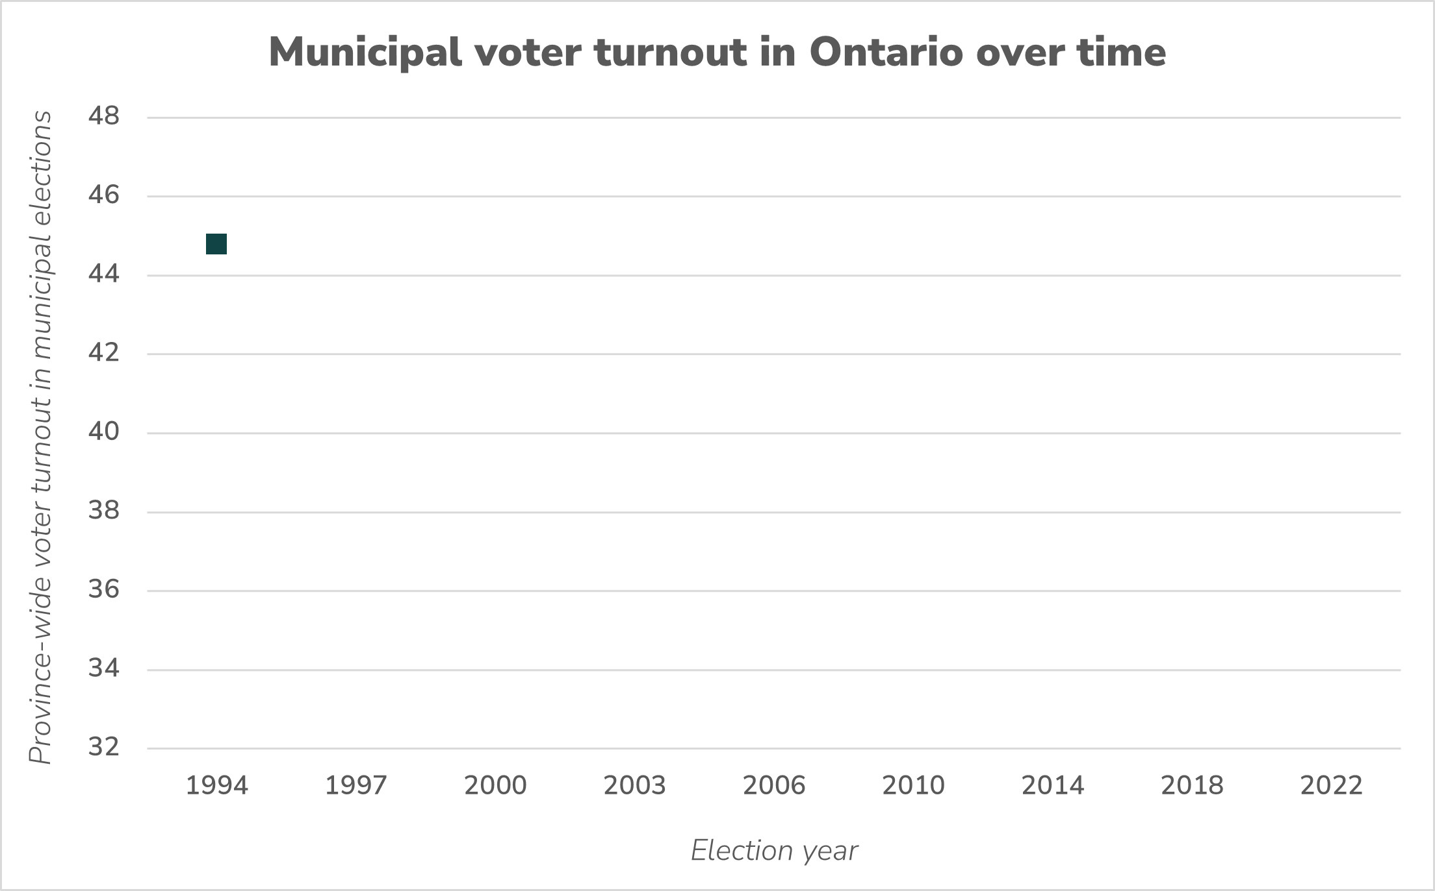

Slide 5
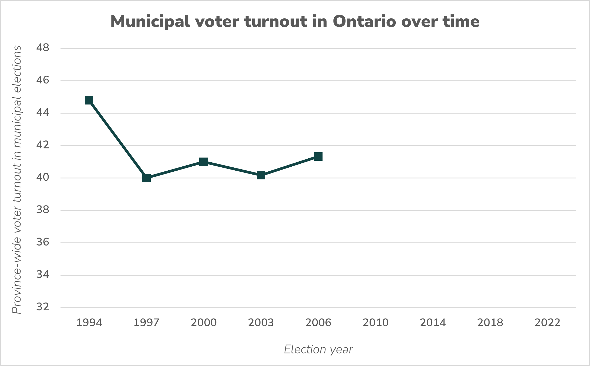

Slide 6
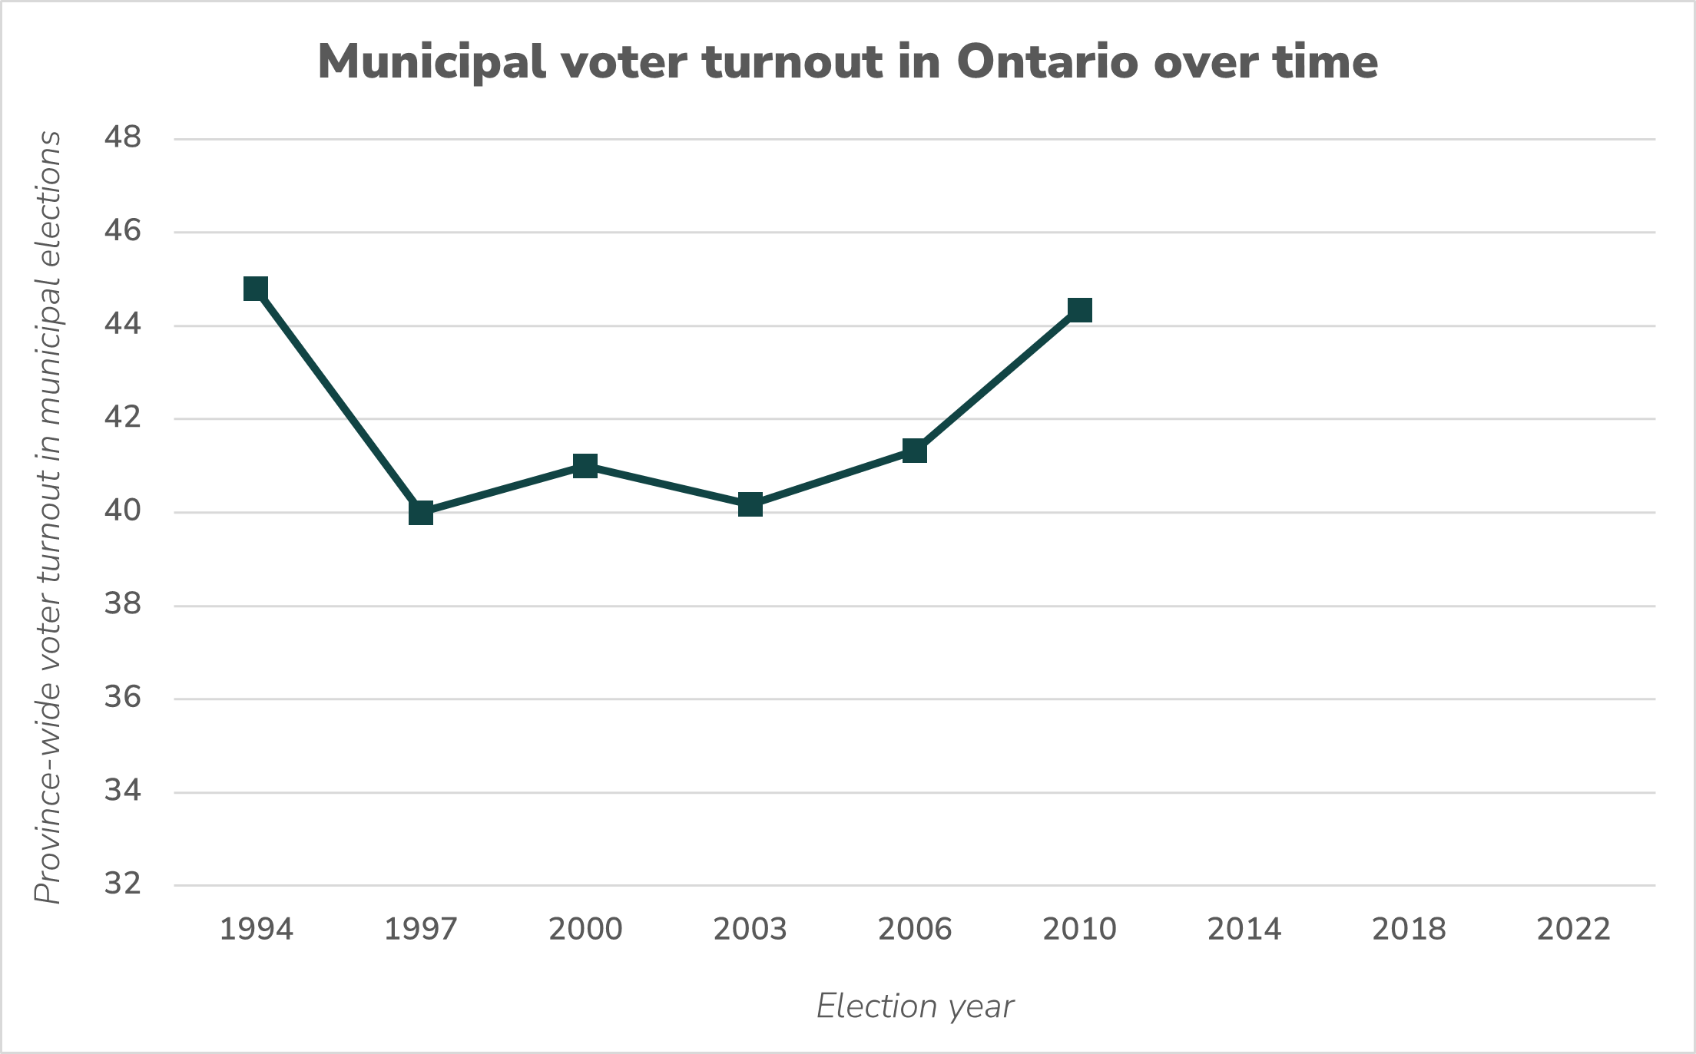

Slide 7
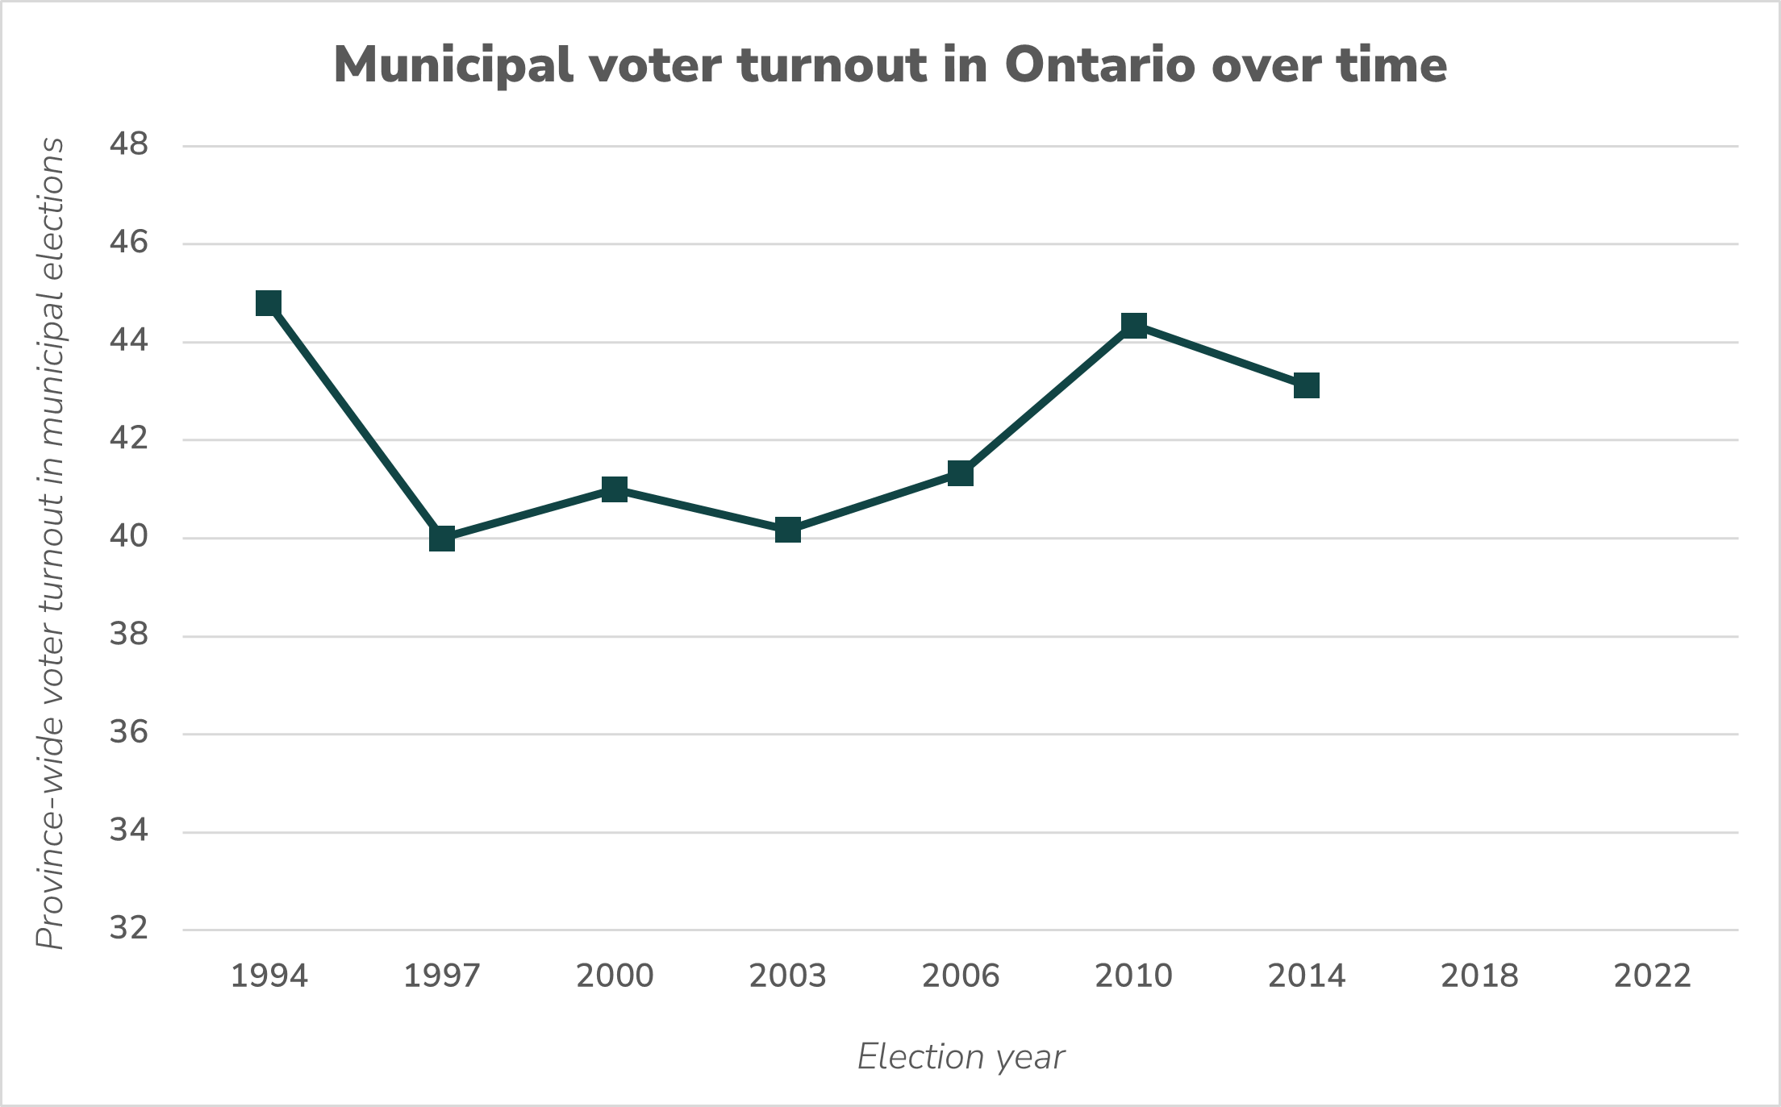

Slide 8
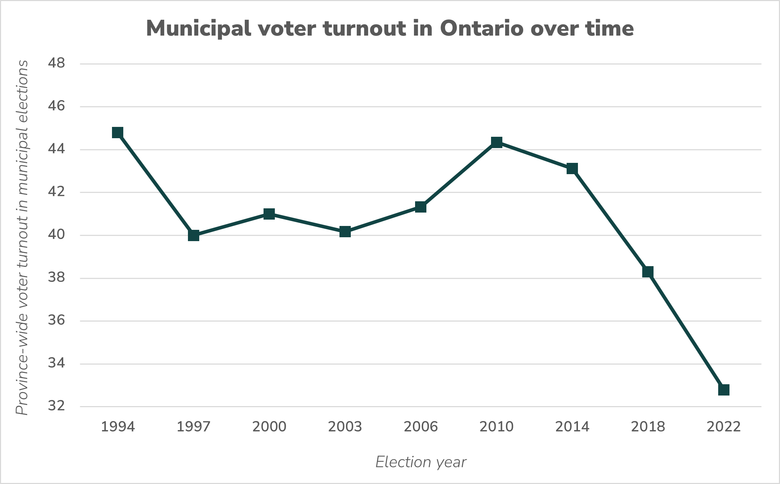

Slide 9
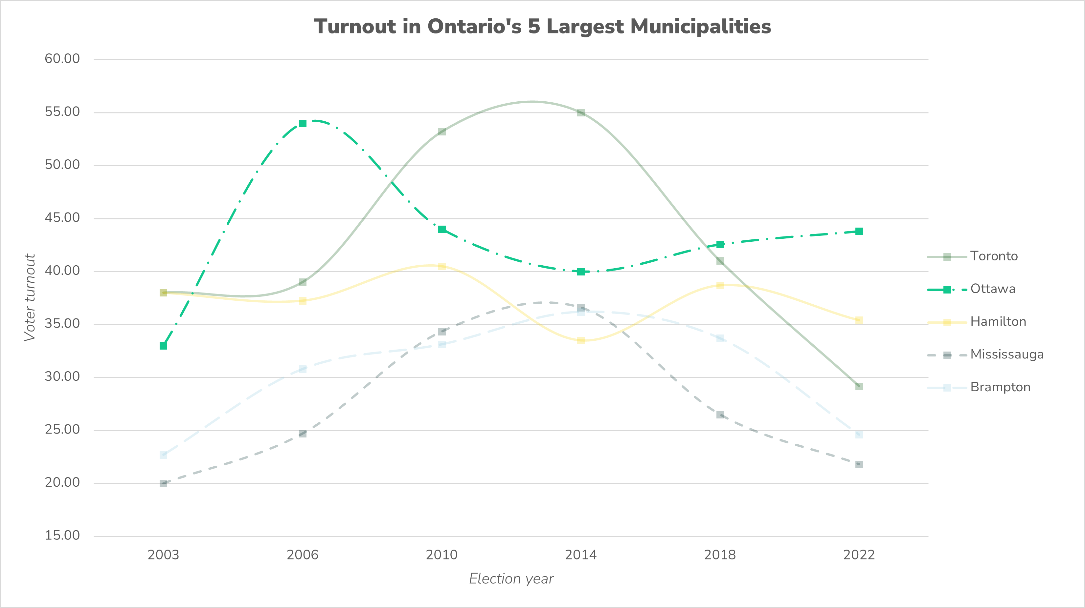

Slide 10
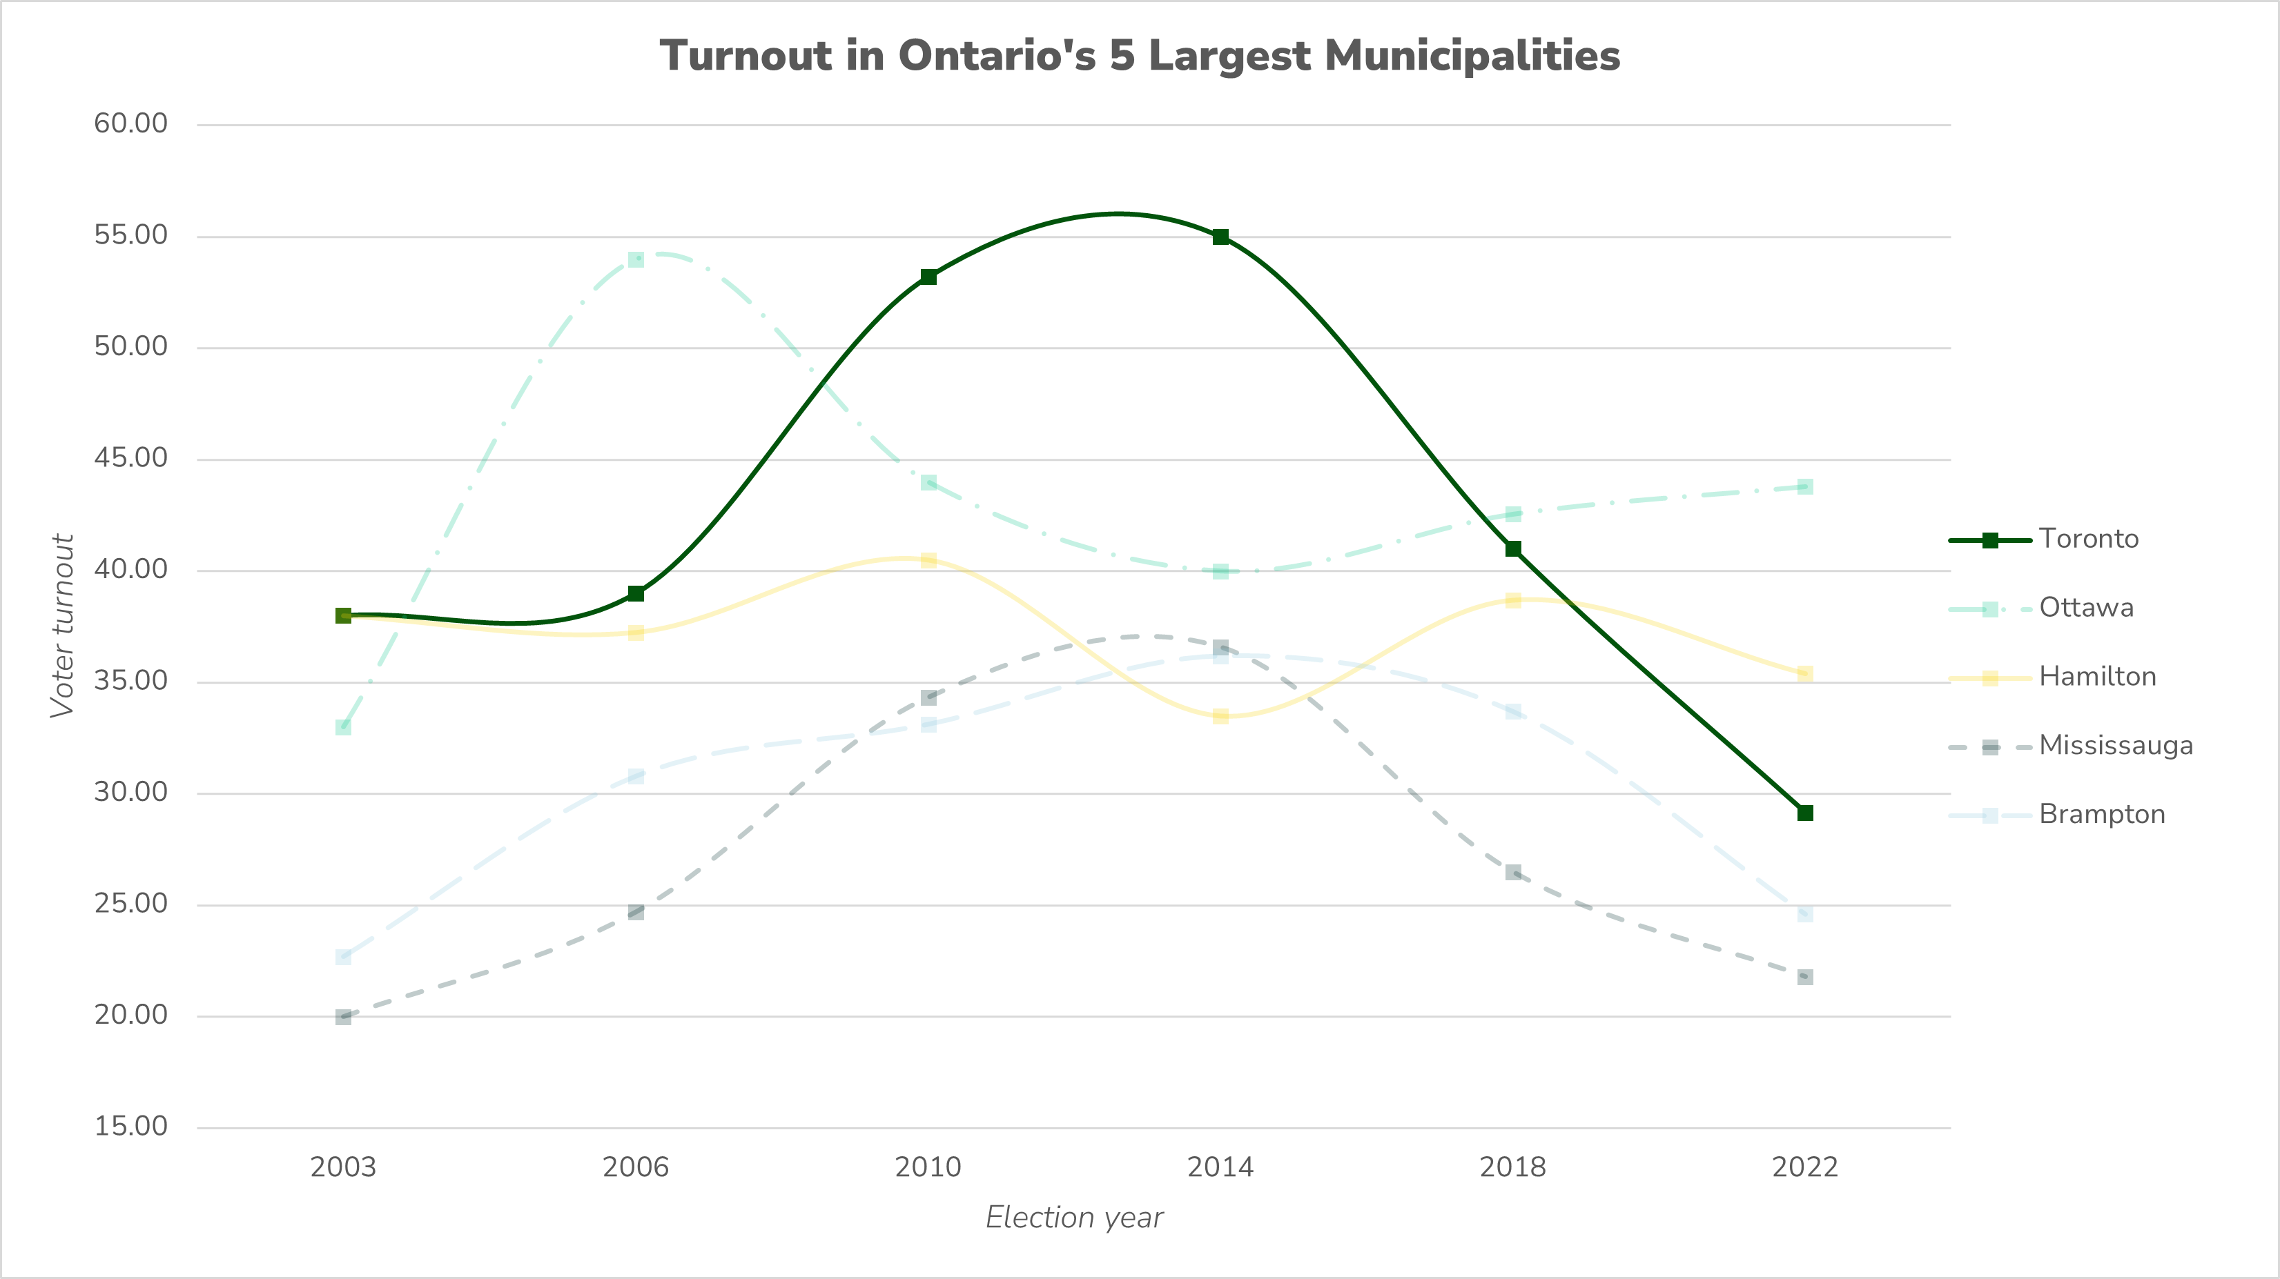

Slide 11
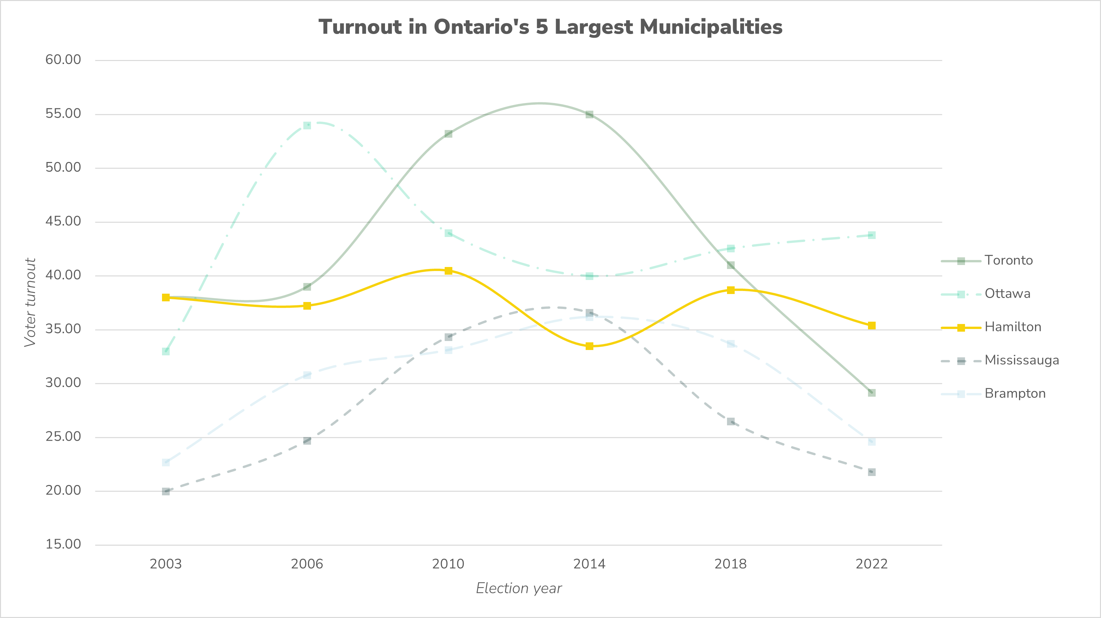

Slide 12
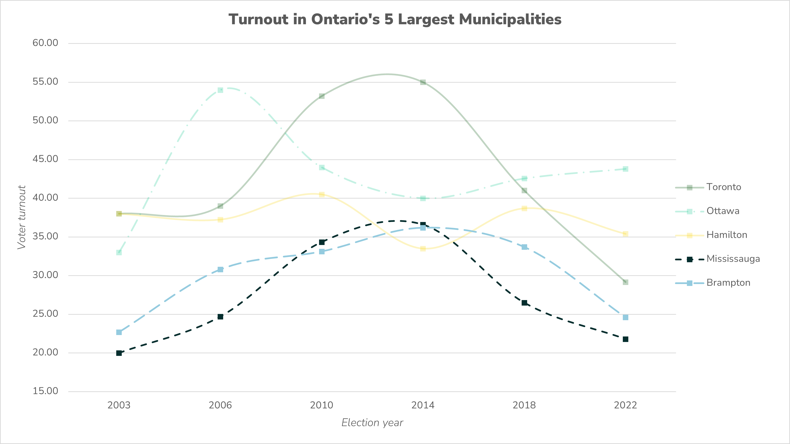

Slide 13
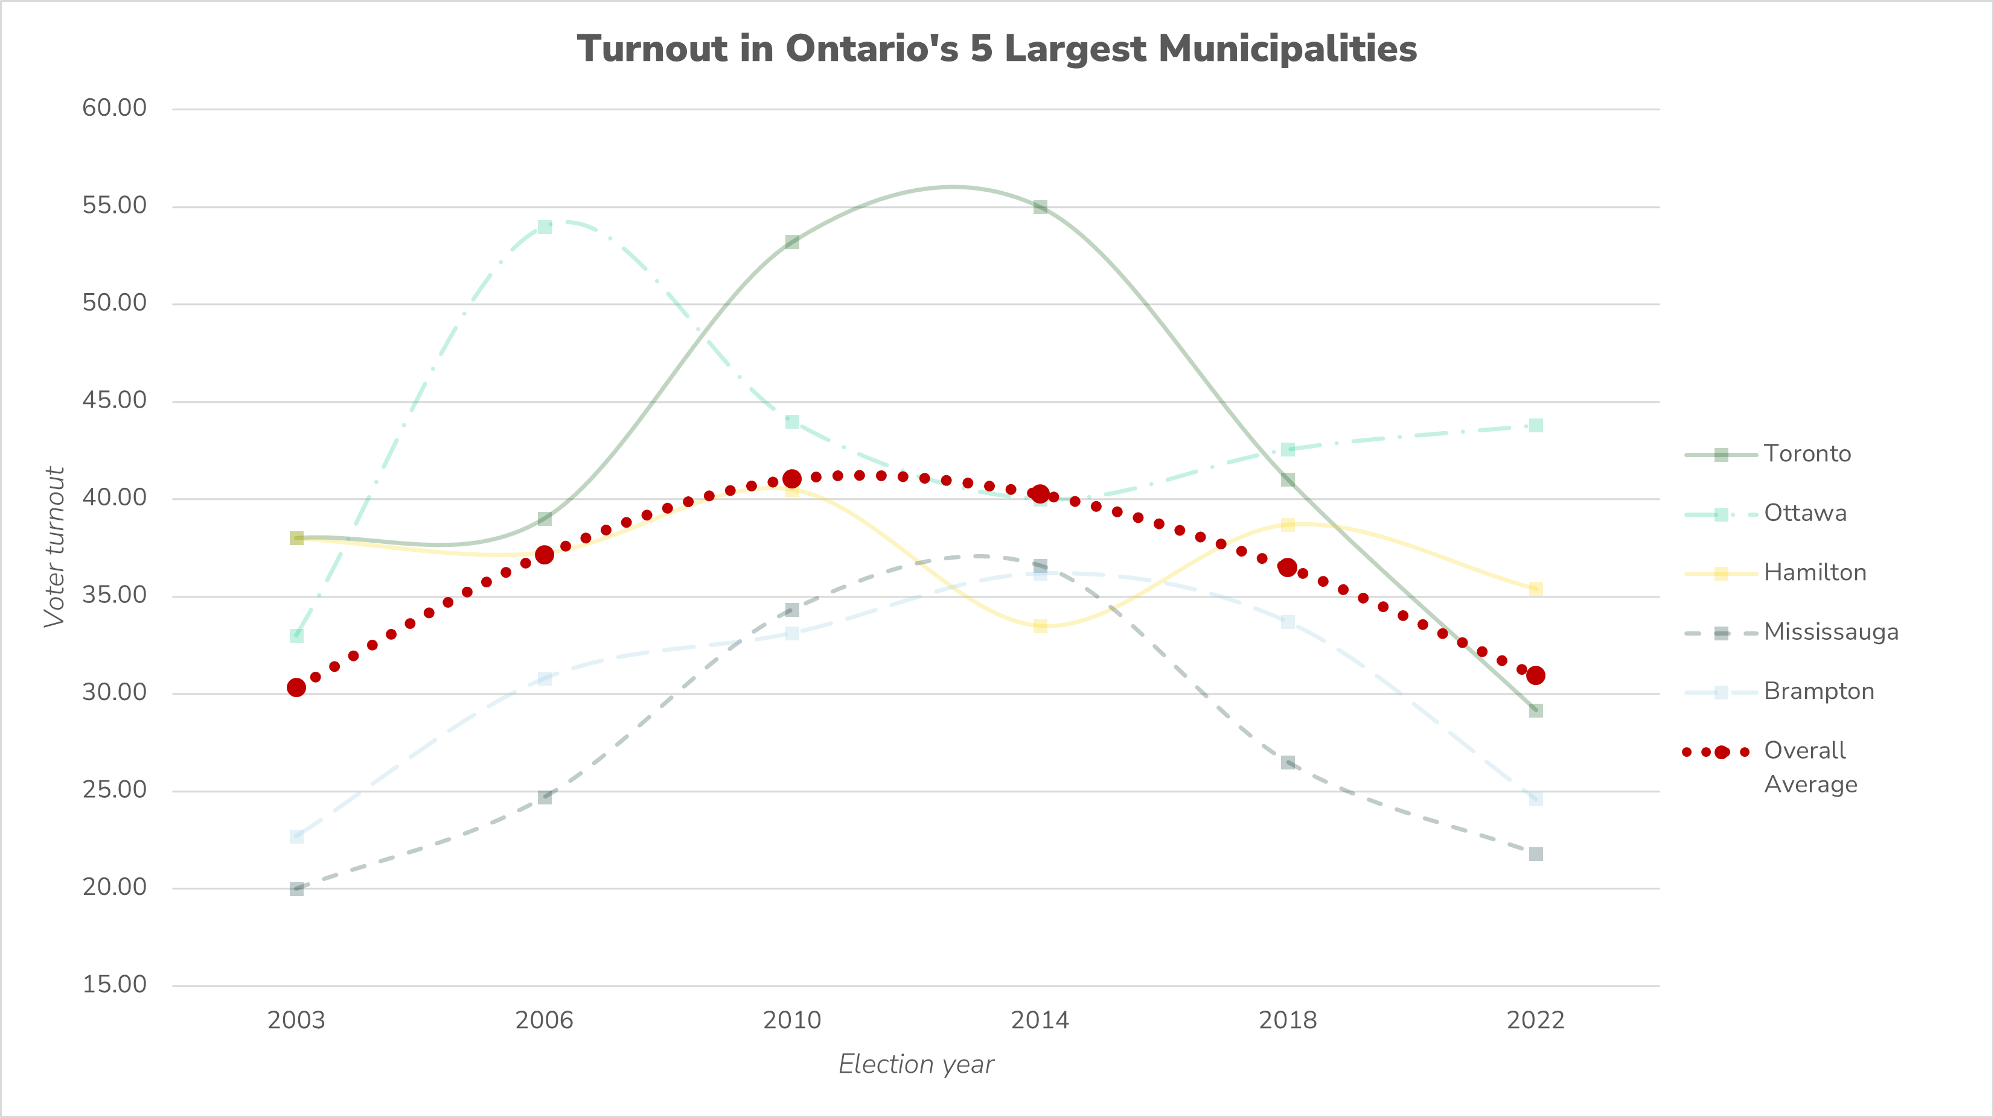

Slide 14
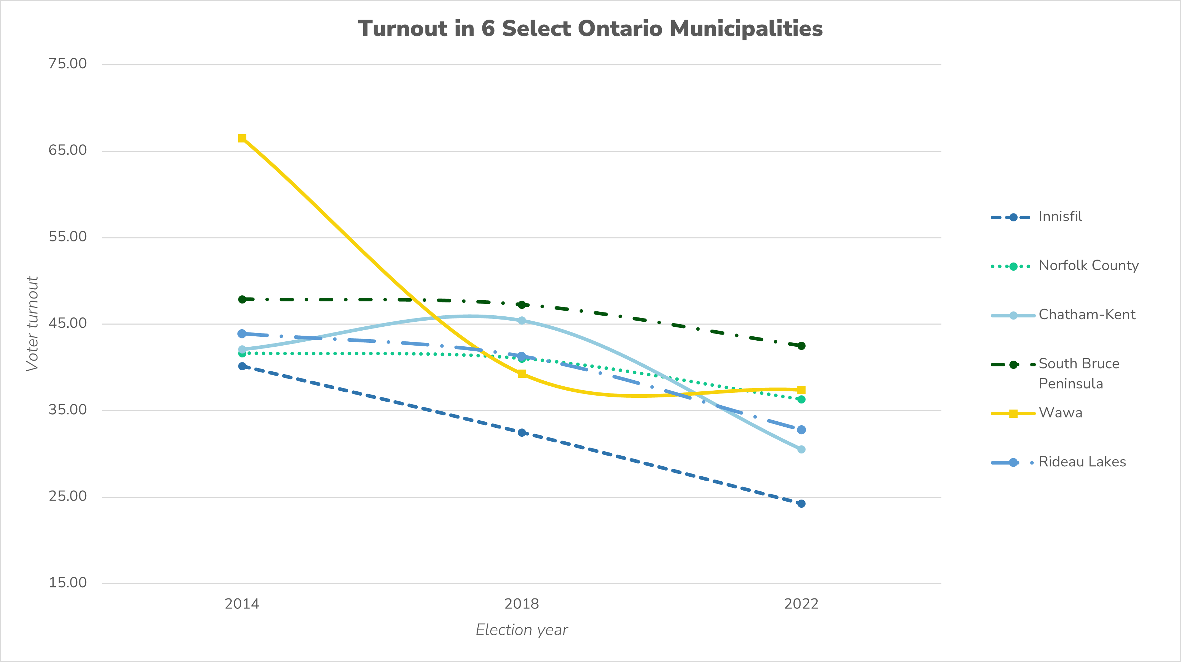

Slide 15
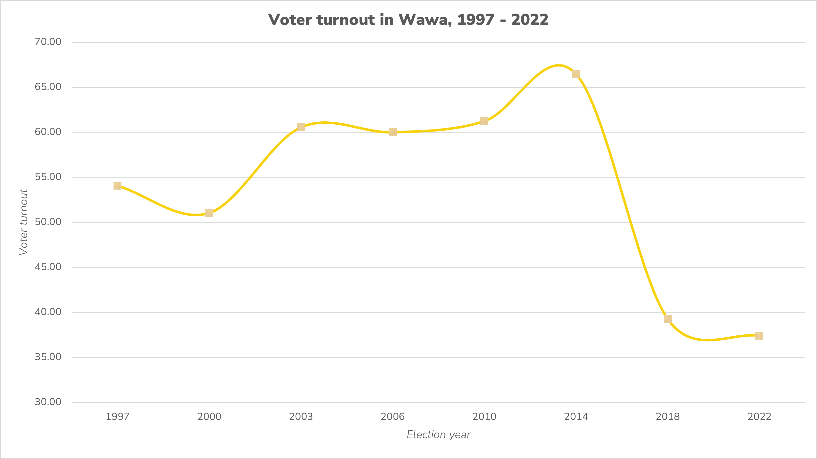

Slide 16
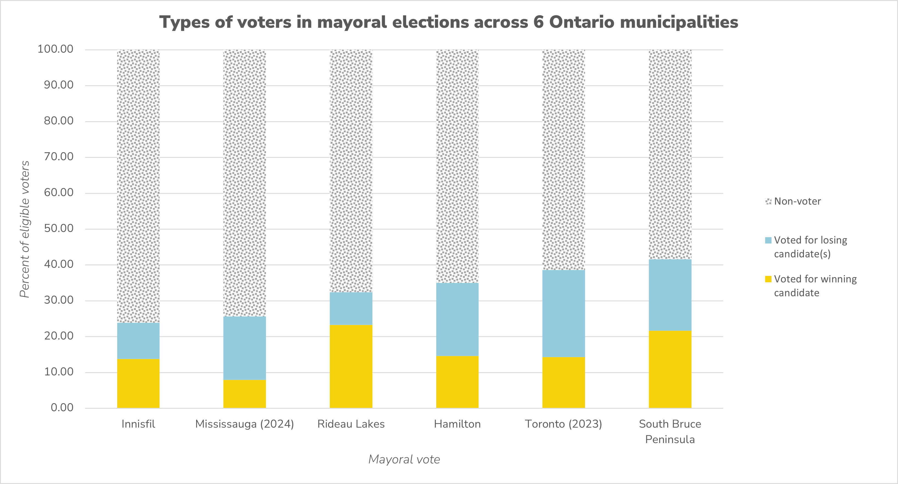

Slide 17
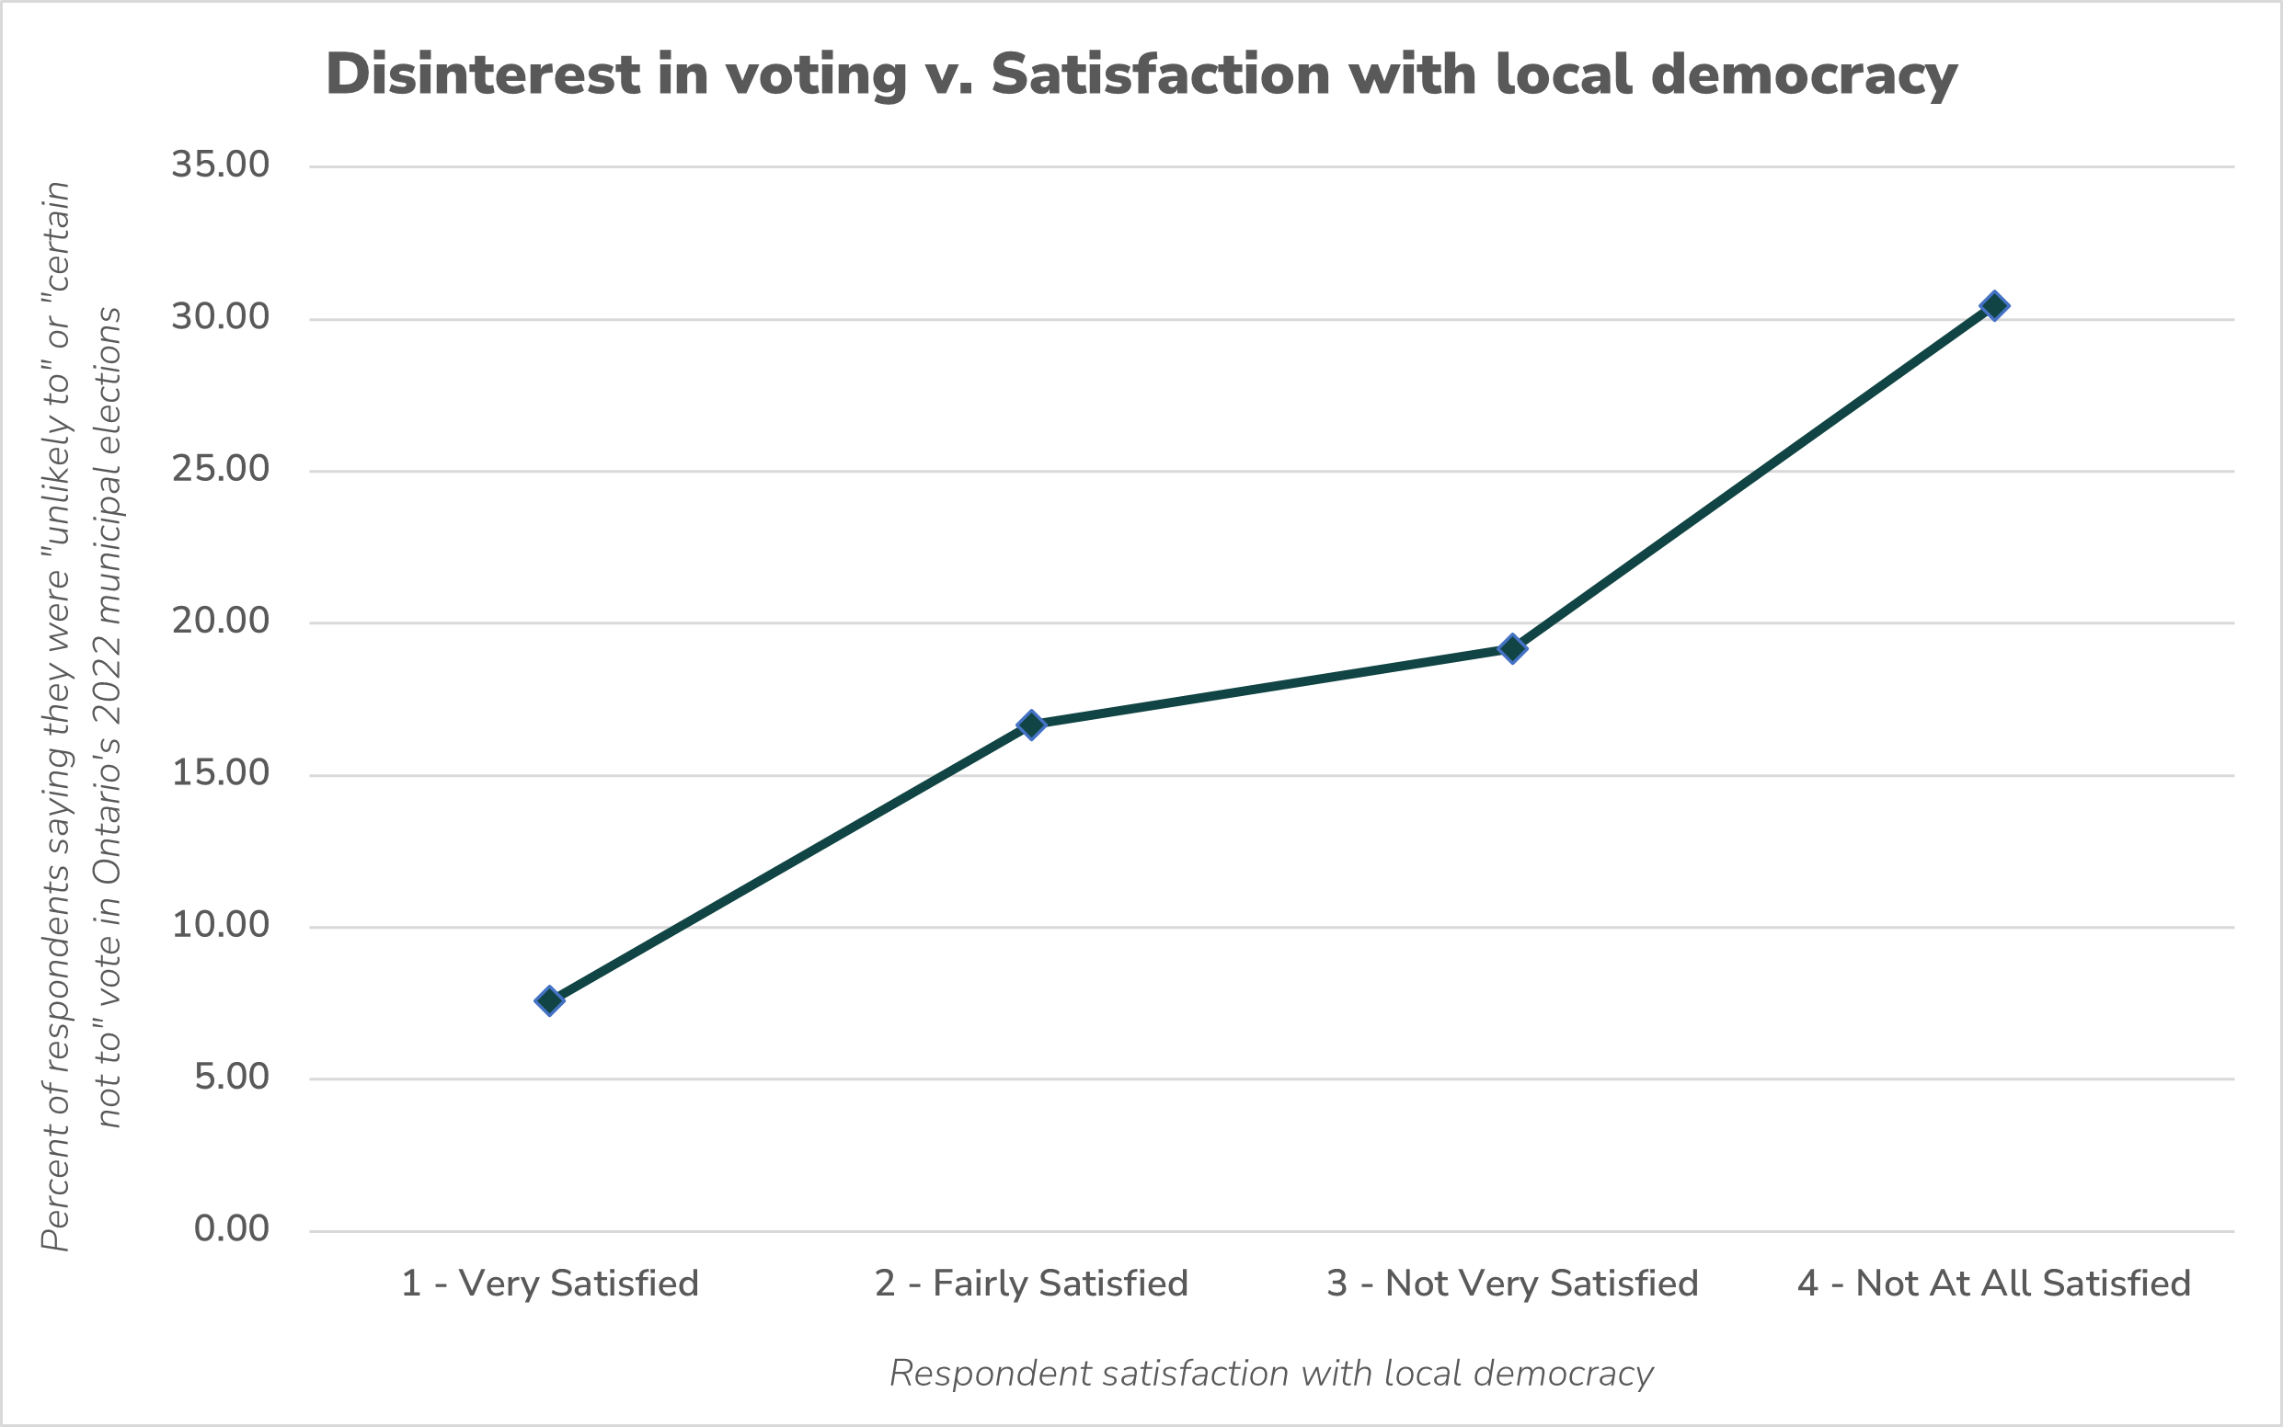

Slide 18
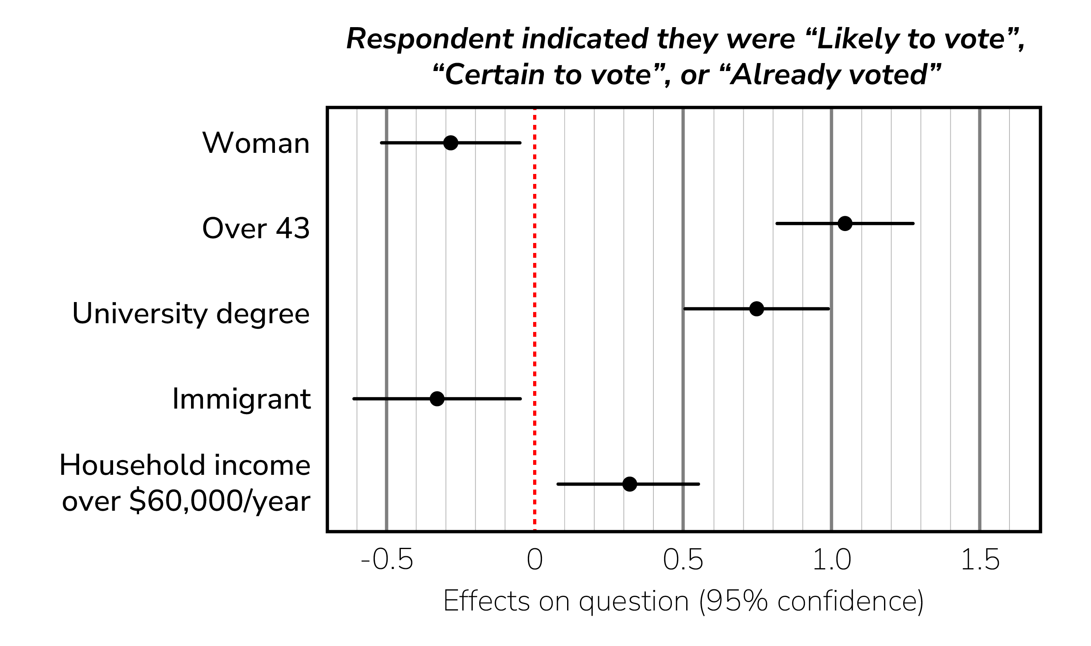

Slide 19
Seven ways we can improve local democracy
Building trust and building connections

Slide 20
Supporting candidates and newly elected officials
Running for local office and navigating the first years on council can be challenging. By identifying solutions that draw on the lived experiences of other candidates and elected officials or connecting people with support networks, people with civic ambition can be paired with the support they need to run effective campaigns and hit the ground running after the election.
Photo by Daniel Hodson on Unsplash

Slide 21
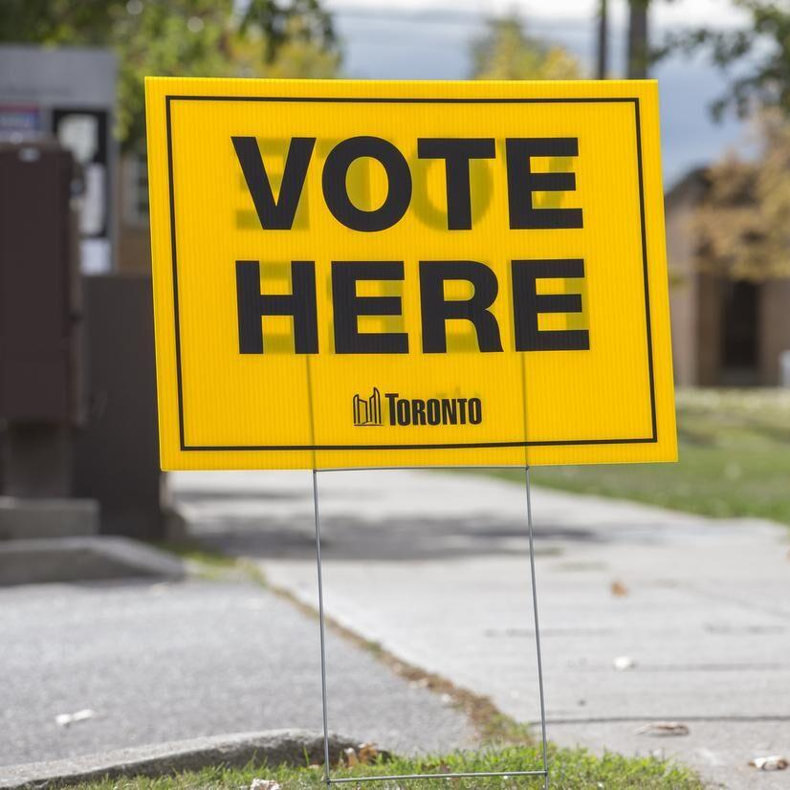
Improving electoral participation
A strong democracy is one where people feel like participating in the electoral process is easy and accessible. These solutions focus on increasing voter turnout, improving electoral participation, and making elections accessible to everyone.
Photo by Rich Madonik from the Toronto Star

Slide 22
Encouraging Democratic Participation
Everyone in a municipality needs a strong toolkit in order to tackle big issues. Ensuring everyone has access to the tools and information they need to advocate for their communities and future can help build vibrant and inclusive communities. These solutions will help residents, legislators, and organizations improve everyday democratic participation and help address the big issues in their communities.
Photo by Toa Heftiba on Unsplash

Slide 23
Countering misinformation and supporting local media
A healthy local media ecosystem is important for getting information out to voters, residents, and stakeholders. These solutions aim to support local media, share information critical to democratic participation, and push back against the threats of misinformation and foreign interference.
Photo by Korie Cull on Unsplash

Slide 24
Engaging Diverse Communities
A community’s strength is in its diversity. People from all walks of life have unique and important experiences to share, which can help build trust in the system, improve policy outcomes for all residents, create bonds between people, and strengthen our local democracy. These solutions aim to bring people together and ensure their valuable viewpoints are part of our civic conversation.
Photo by Nina Strehl on Unsplash

Slide 25
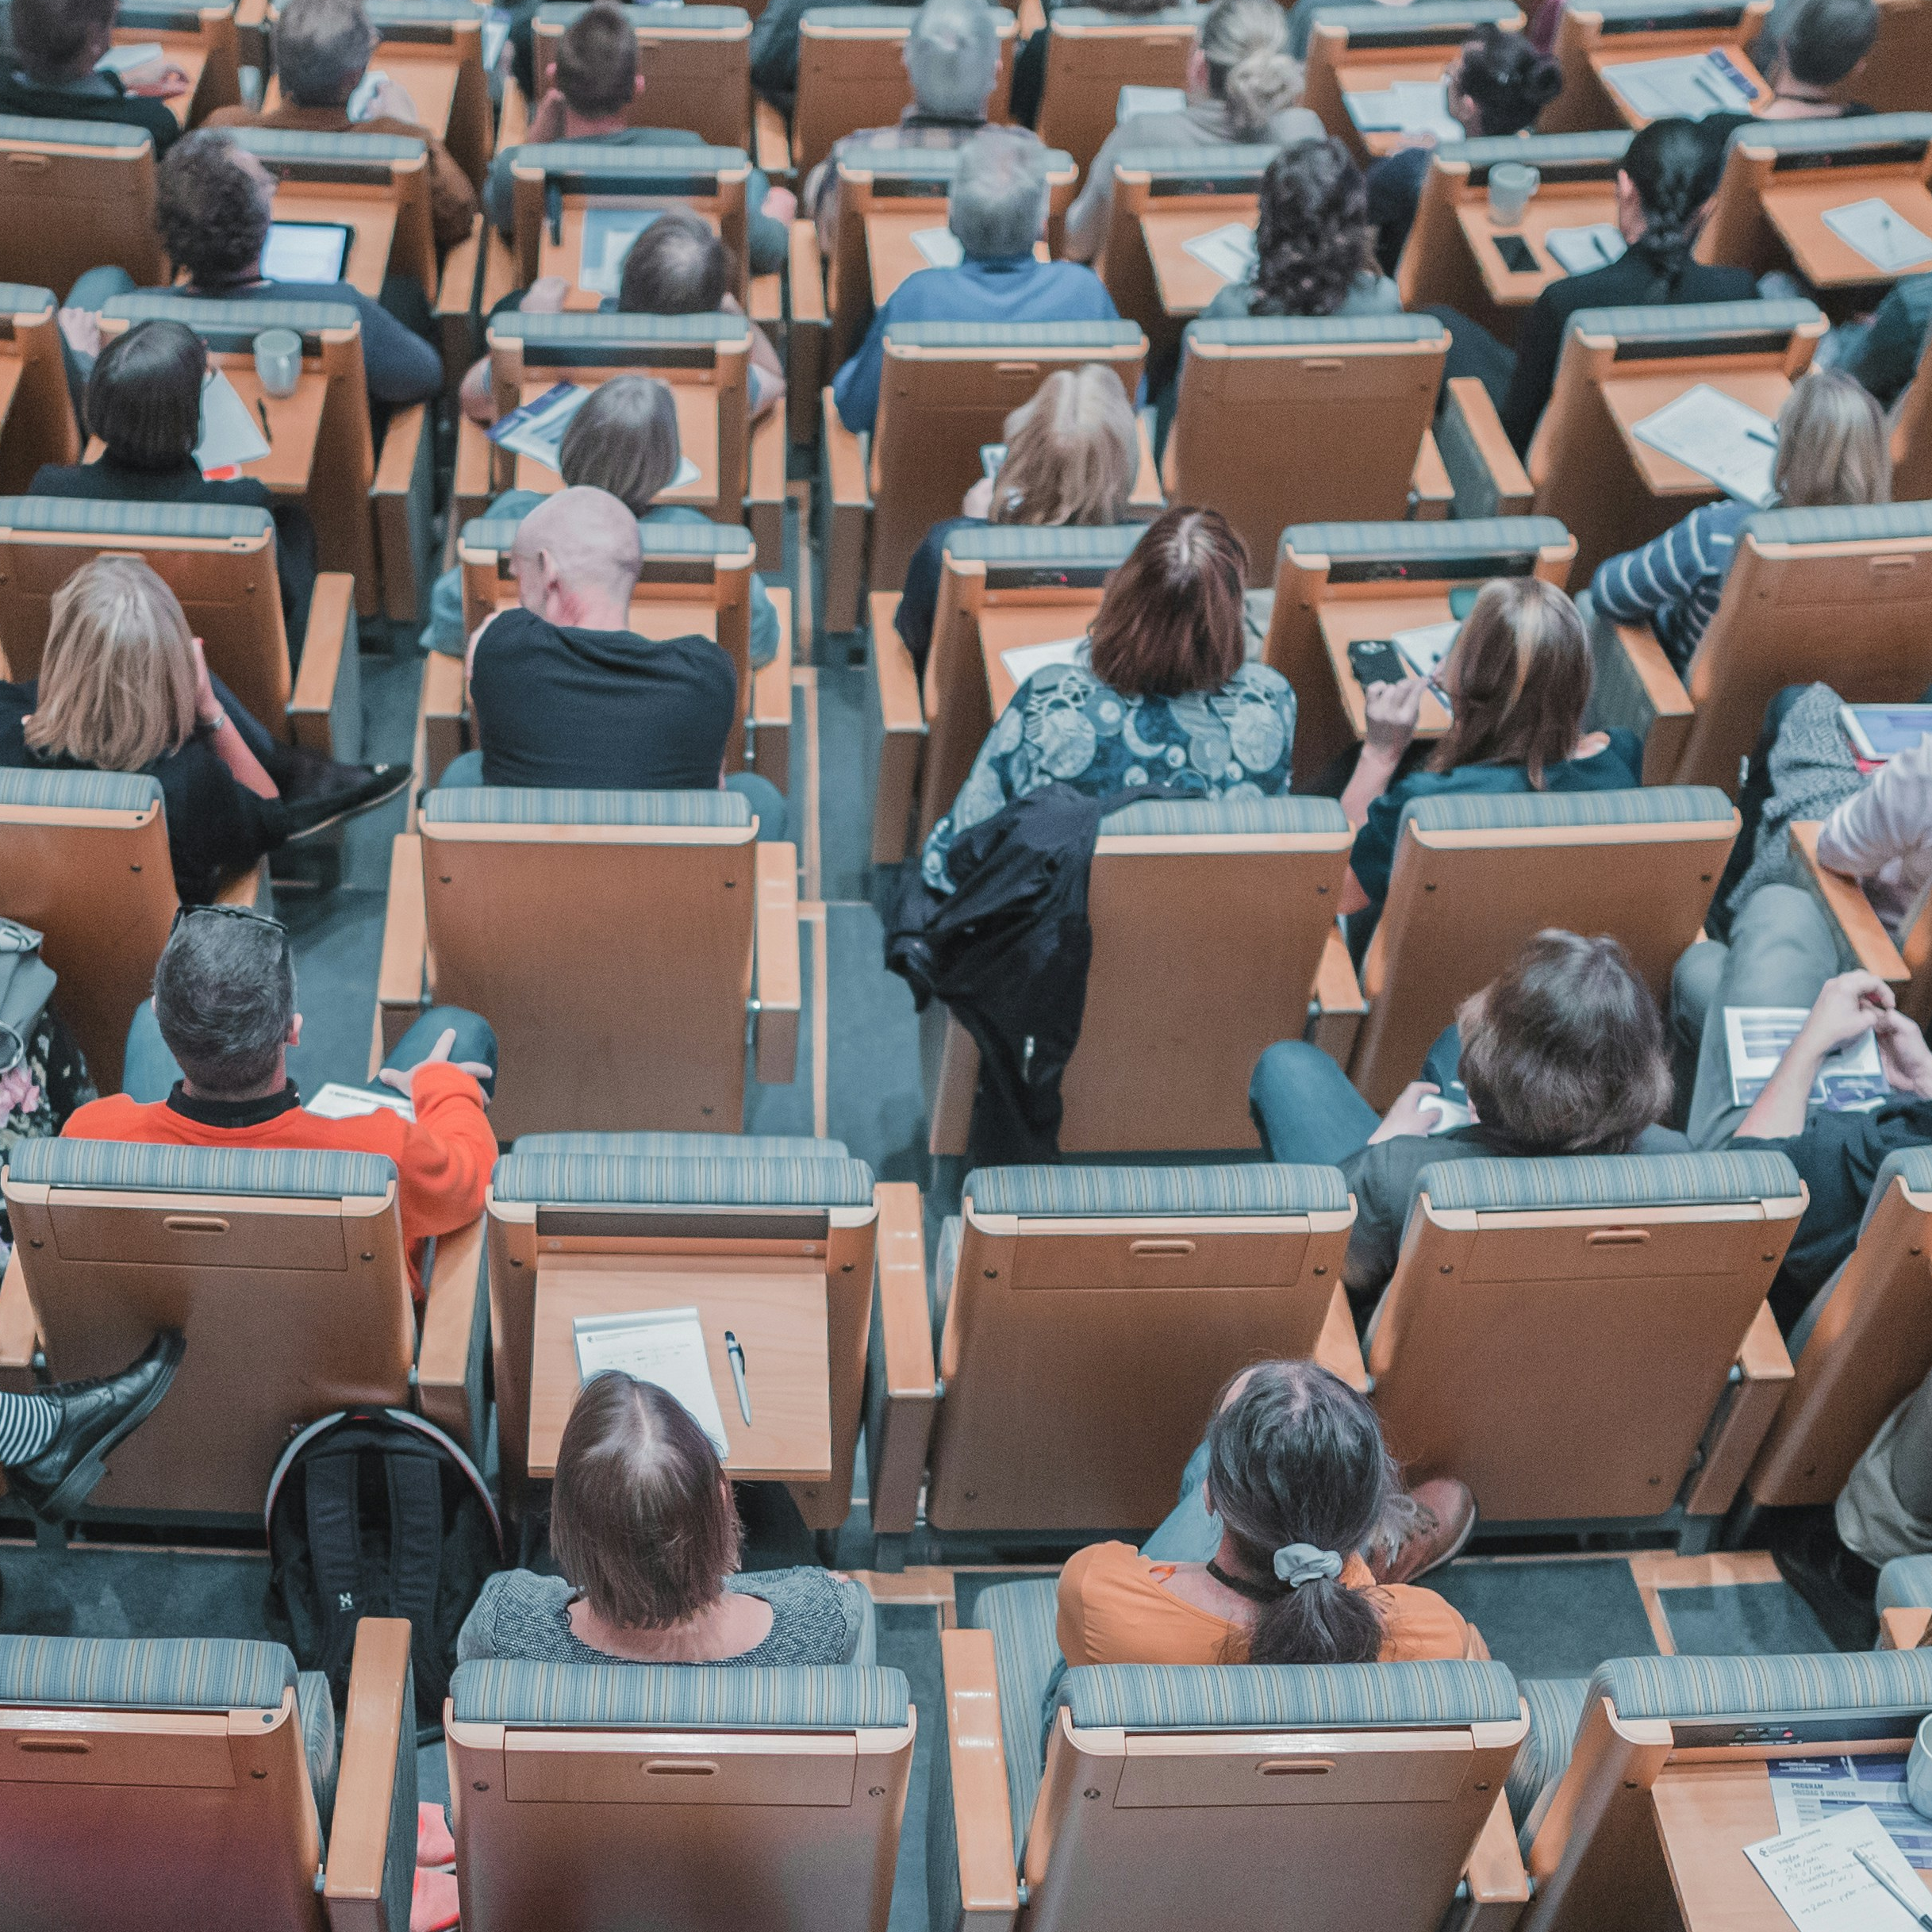
Improving Civic Education
It can be challenging to understand what a local government does, from how municipalities raise revenue and provide services to how council functions. But it is essential that residents and community groups have the best possible information to help them be engaged, connected, and empowered citizens who are ready to advocate for issues that matter to them. These solutions aim to raise awareness about municipal government, improve civic education, build skills necessary to become community advocates, and create education and awareness campaigns.
Photo by Mikael Kristenson on Unsplash

Slide 26
Fostering civility and respect
Tension, toxicity, and distrust permeate too much of our politics today. Everyone – citizens, community groups, elected officials, and municipal employees – deserves to feel safe, heard, and respected when engaging with and within local institutions. These solutions aim to reduce toxicity in political interactions and promote respectful discourse between residents, elected officials, and public servants.
Photo by Priscilla Du Preez on Unsplash

Slide 27
Shared knowledge
Learning from one another

Slide 28
Adaptable and targeted
Flexible and tested
Unique and replicable
Solutions need to be specific enough to meet the unique needs of each municipality or group, but adaptable enough to be applied to their unique situation.
Solutions need to have data, longevity, or a strong theoretical foundation while also not being so rigid that they cannot be altered or adapted based on each user’s needs.
Solutions need to be unique, interesting, and worthwhile in order to stimulate interest in local democracy while also having an element of replicability so that they can be used over time and across many places.

Slide 29
Solution partners
Solution type
Solution level
Governments
Non-profits, charities, or community-based organizations
Academic institutions
Resident-led community-groups
Elected officials, candidates, and campaigns
Media institutions
Meetings, activities, and training
Reports and recommendations
Organizations, committees, and positions
Funding
Resources and information
Policies and initiatives
National, sub-national, and/or local
Country of origin
Province
Municipality
Municipality size, form, and tier
Municipal population

Slide 30
Solution partners
Solution type
Solution level
Governments
Non-profits, charities, or community-based organizations
Academic institutions
Resident-led community-groups
Elected officials, candidates, and campaigns
Media institutions
Meetings, activities, and training
Reports and recommendations
Organizations, committees, and positions
Funding
Resources and information
Policies and initiatives
National, sub-national, and/or local
Country of origin
Province
Municipality
Municipality size, form, and tier
Municipal population
How long solution has been in use
How long the solution takes to enact
Which specific organizations are involved
What are the stats and analytics on the solution
Where did funding for the solution come from

Slide 31
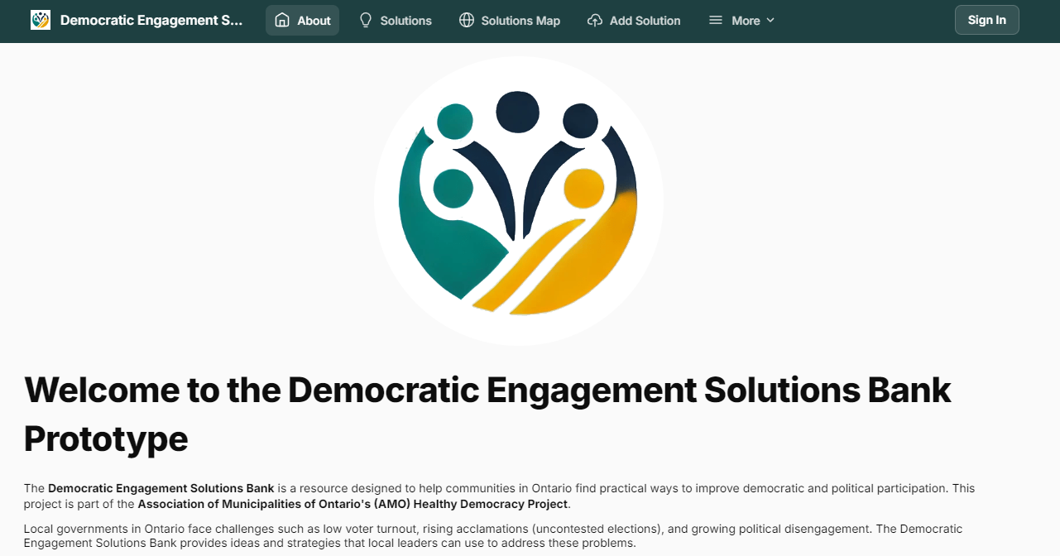

Slide 32
How it works
Putting theory into practice

Slide 33
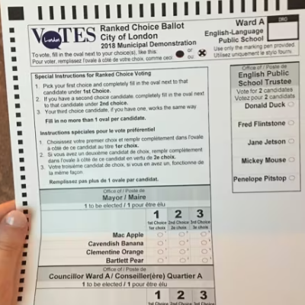
Congratulations! You’ve been elected to local office.
But now the hard work begins. You want to improve local democracy, but aren’t sure where to start. That’s where the Democratic Engagement Solutions Bank comes in!
Photo by Hala Ghonaim from the CBC

Slide 35
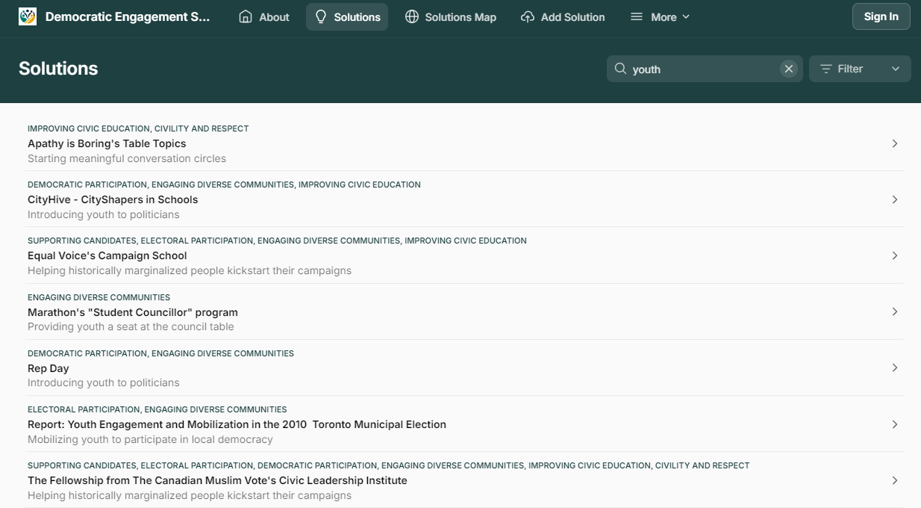

Slide 37
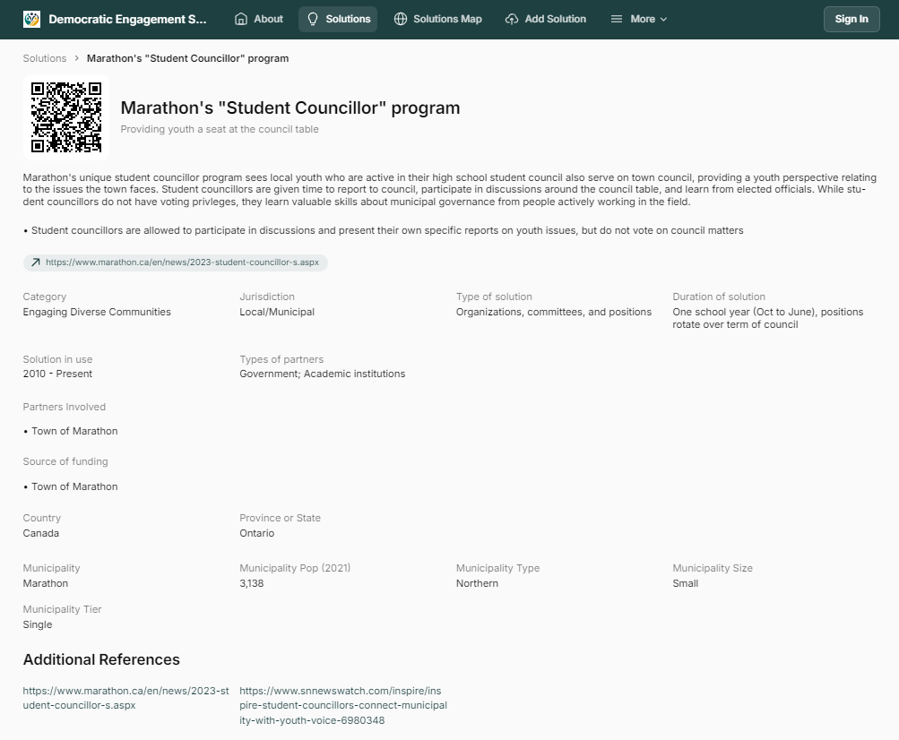

Slide 38
Categories
Solution type
Solution partners
How long the solution takes to enact
How long solution has been in use
Which specific organizations are involved
Solution level
Where did funding for the solution come from

Slide 40
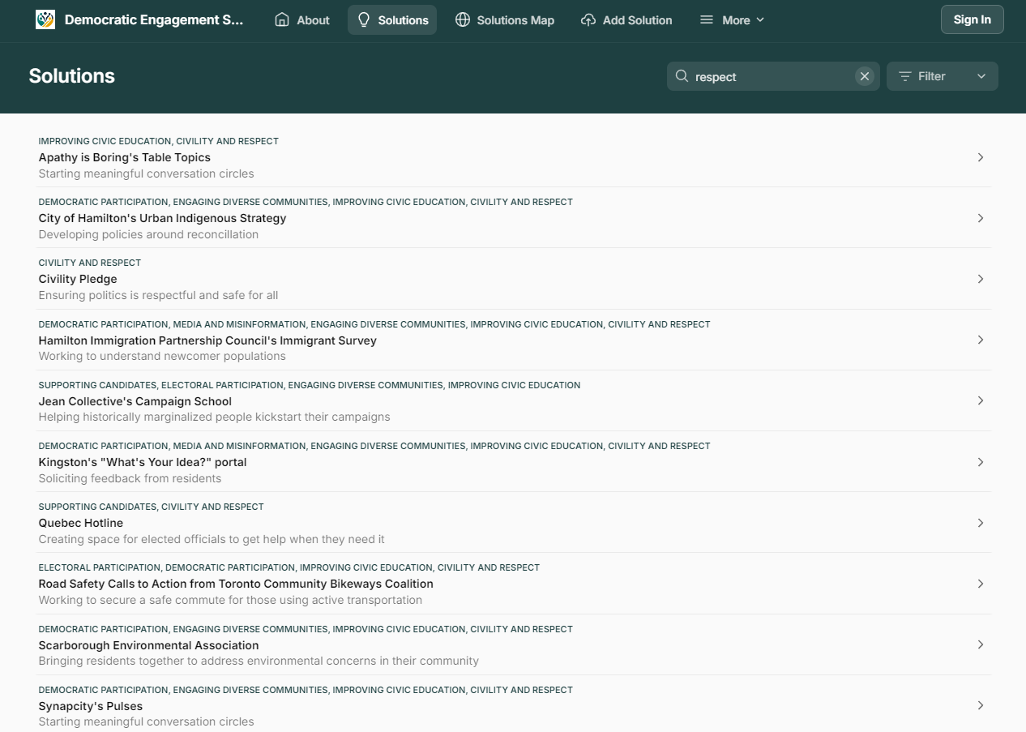

Slide 41
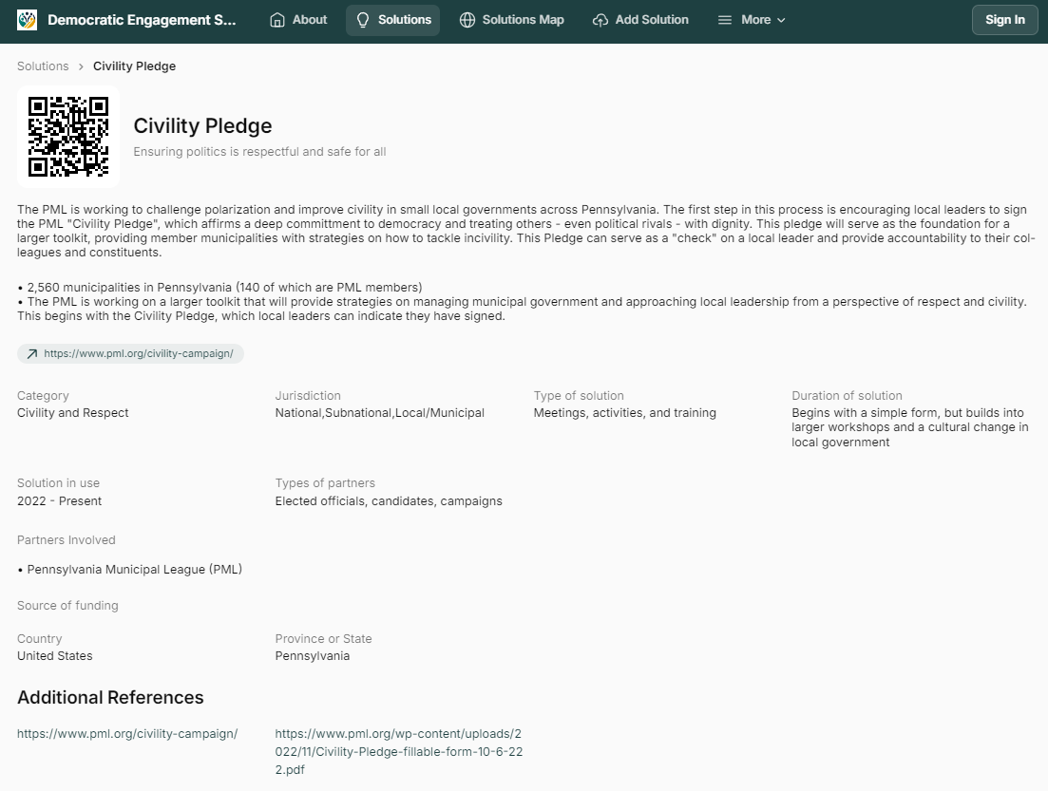

Slide 42
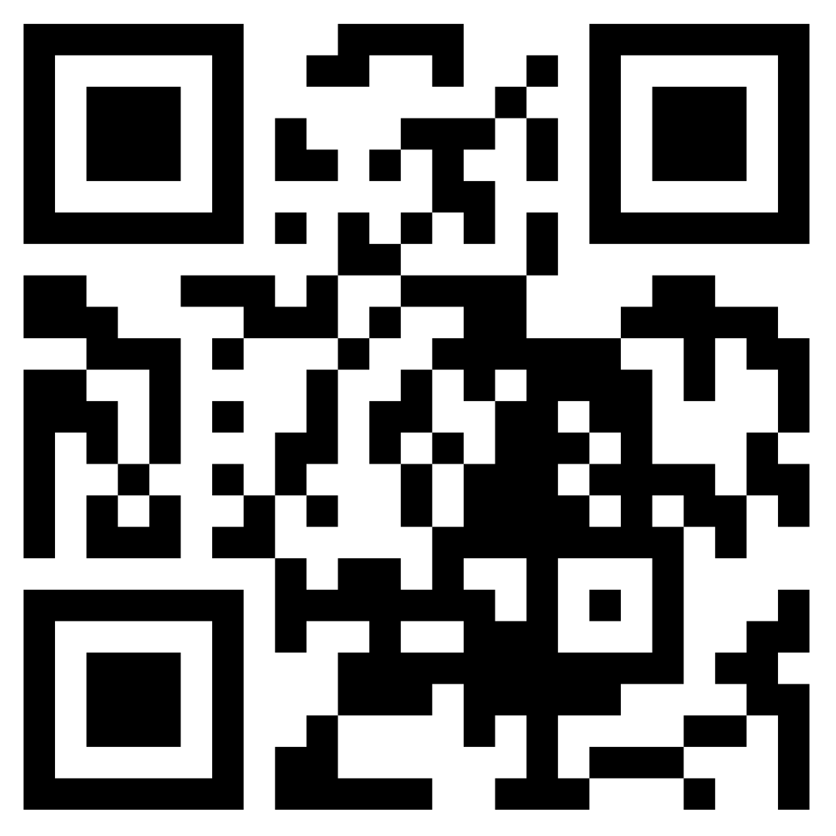
Try out the Democratic Engagement Solutions Bank prototype yourself

Slide 43
Moving forward
Expanding this resource for everyone

Slide 44
State of the project so far
54 unique projects from around the world
Solutions that have been used for over 100 years and some that have not even been implemented yet
Solutions that municipalities and affiliated groups can quickly implement and change to long-term, lasting solutions

Slide 45
State of the project so far
Goals for the project
54 unique projects from around the world
Solutions that have been used for over 100 years and some that have not even been implemented yet
Solutions that municipalities and affiliated groups can quickly implement and change to long-term, lasting solutions
Crowdsource solutions from across Ontario, Canada, and the world
Update projects based on their outcomes and how they’re used in new settings
Work with researchers and municipalities to study how these solutions work once implemented
Connect civic leaders through the Democratic Engagement Solutions Bank

Slide 46
Thank you
Chris Erl
Researcher with the Democratic Engagement Exchange at Toronto Metropolitan University
christopher.erl@torontomu.ca

