Slide 1

Turn Up the Turnout
A Resource on Voter Participation in Local Elections
Notes:
Stew

Slide 2

AMO’s Healthy Democracy Project
AMO’s Healthy Democracy Project promotes the value and importance of municipal governments in Ontario's political system, including the importance of diversity of leadership and perspectives.
The Healthy Democracy Project builds on AMO’s 2021—2022 We All Win campaign and works to:
  Attract more diverse candidates to municipal office.
  Support elected officials to be equity-informed leaders.
  Promote more respect for the people engaged in democratic processes.
  Encourage greater participation in local democracy and an increase in voter turnout.
  Promote greater civic engagement and greater awareness of the role of municipal government.
Notes:
Stew

Slide 3
AMO’s Healthy Democracy Project
Foundations, Engagement & Partnerships
Advisory Group provides strategic advice on Healthy Democracy Project direction, research, and initiatives. The Group includes previous and current elected officials, AMCTO, OPSBA, candidate support organizations, national equity-focused organizations.
Through the HDP, AMO engages with a growing variety of aligned partners:
  Toronto Metropolitan University’s Democratic Engagement Exchange, Apathy is Boring, Monumental Projects, CIVIX, Canadian Municipal Barometer, electHER Now, Politics NOW, Proud Politics, Equal Voice, Nominee, The Jean Collective, Ontario Library Association, Ontario Public School Board Association, Young Politicians of Canada, Rideau Hall Foundation, Future Majority, Tamarack
Notes:
Stew

Slide 4

We All Win
Respect for
Democracy
Engagement
& Education
Representative councils
Resources, tools, and training
Equity-informed leadership
People running for office don’t feel alone and have recourse
Increase trust in local government
Improving the tone of discourse
AMO as a thought leader on participatory democracy
Civic education and youth engagement
Civic engagement support for AMO members
AMO member engagement in Healthy Democracy work
Notes:
Stew

Slide 5
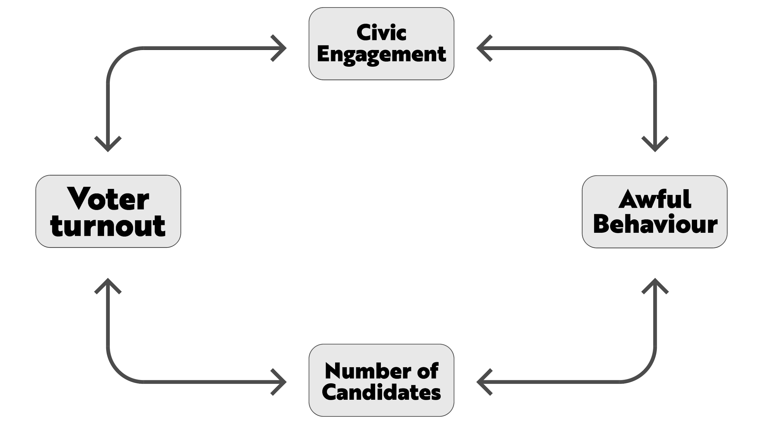
Crowded intersection
Notes:
Stew

Slide 6
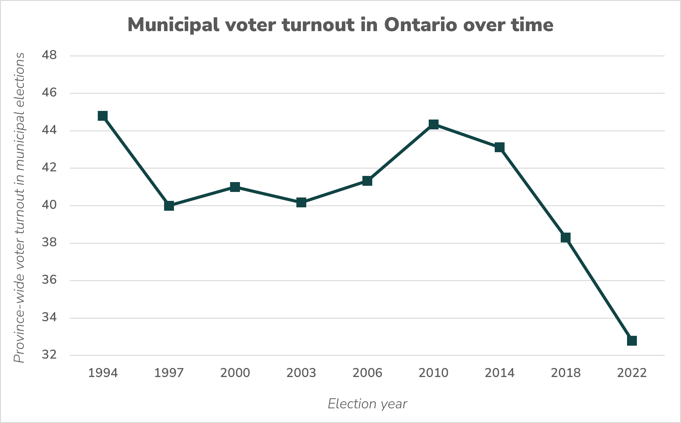
Declining turnout
Notes:
Stew

Slide 7
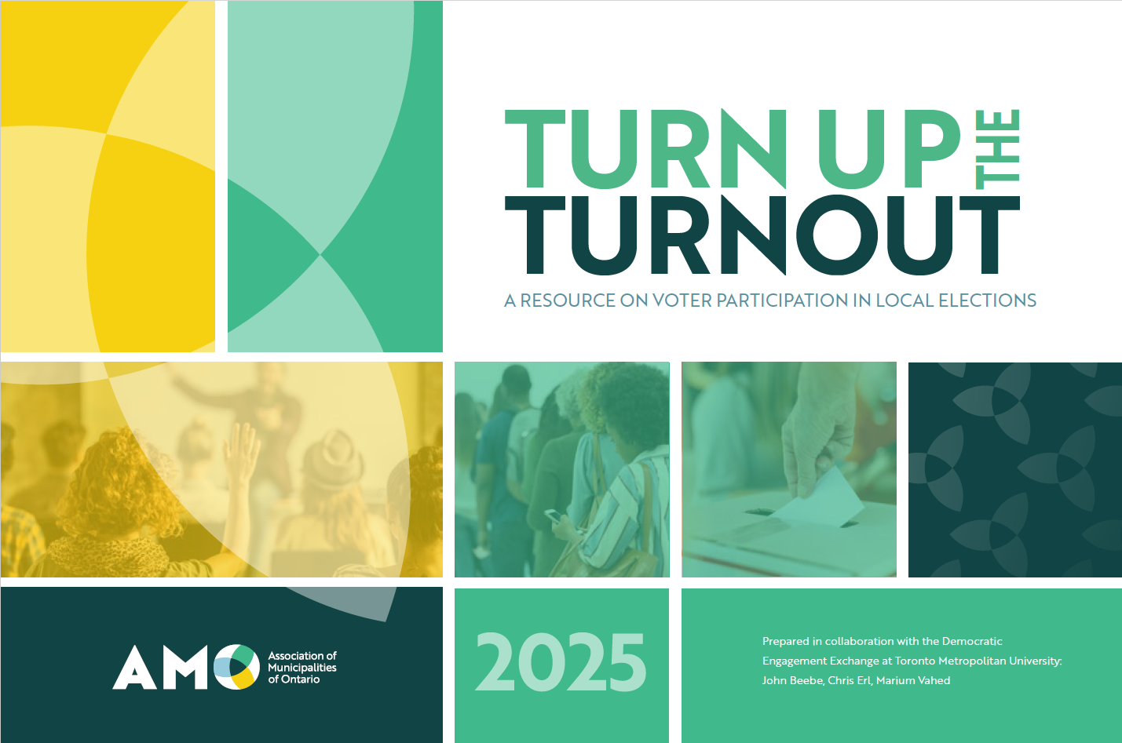
Notes:
Stew

Slide 8

Notes:
Stew

Slide 9
Focus 1:
How do we motivate people to run?
Strengthening beliefs, trust, and norms
Civic education programs
Community-based initiatives
Policies encouraging civic engagement
Strengthening Campaigns and supporting candidates
Candidate forums and debates
Increasing the number of candidates running and seeking re-election
Providing candidate support to people from marginalized groups
Improving voter access to candidates’ experience and policies
Notes:
Stew

Slide 10
Focus 2:
How do we reduce barriers to voting?
Structural barriers
Advance voting days
Different voting methods
Poll locations
Reassuring voters
Targeted accessibility measures for minority communities
Educational barriers
AMO resources
Political campaigns
Non-partisan campaigns
Notes:
Stew

Slide 11
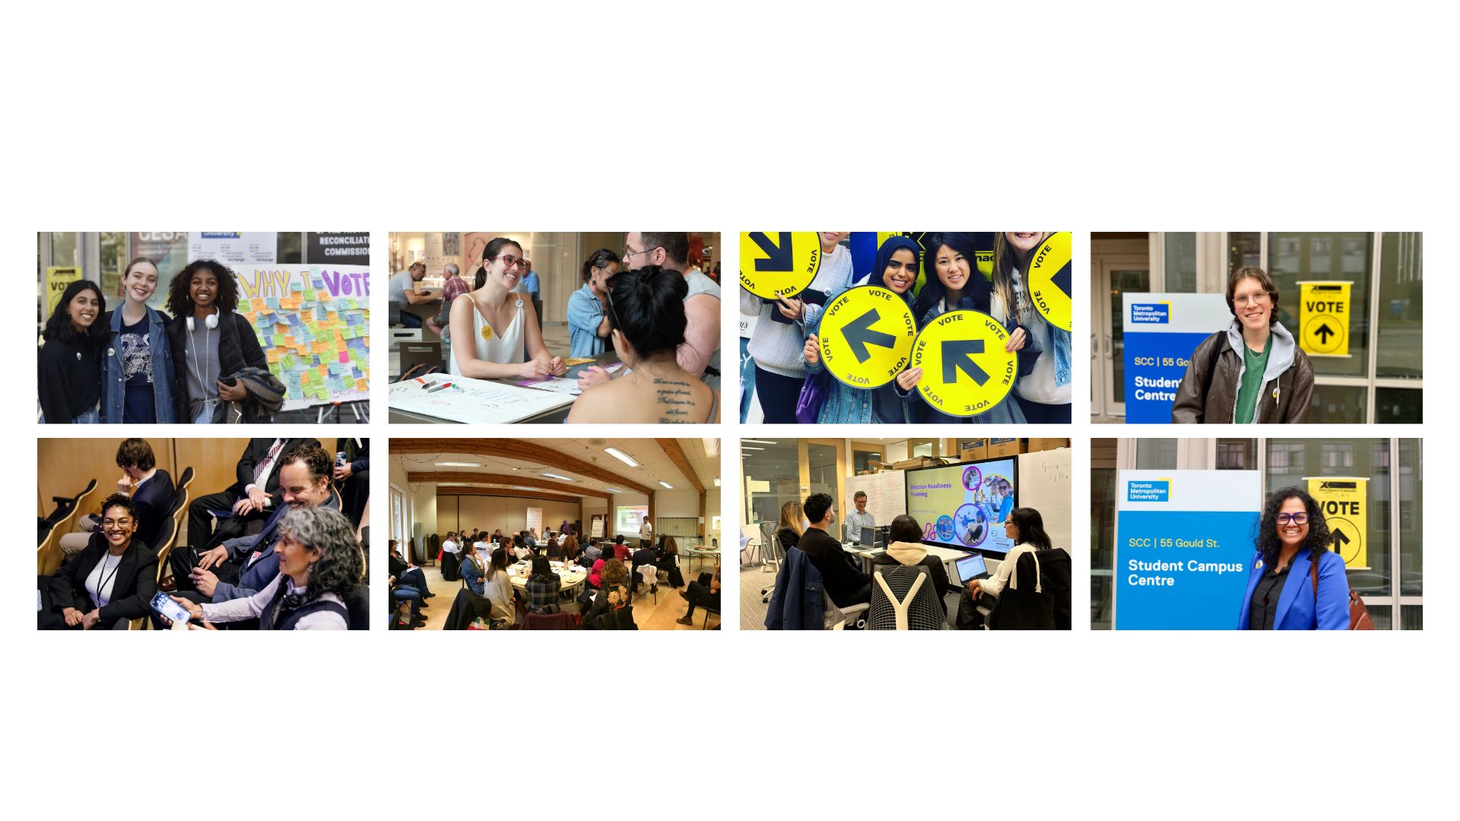
Building a Culture of Engagement
Notes:
With the scale of the challenge, it is important to build a culture of engagement, where people feel hopeful about and connected to shaping the future of their communities and neighbourhoods.
It requires effort to create and sustain self-propagating community connections. This is a multi-year and multi-election cycle challenge. However, voting and supporting turnout is a critical part of this process.
With the municipal elections around the corner, this is a moment where it’s important to think through the framework of factors that impact voter engagement and the strategies we can take.
With limited time today, I will focus on a couple of principles that undergird this work and a selection of promising strategies to increase voter turnout from Turn Up the Turnout.

Slide 12
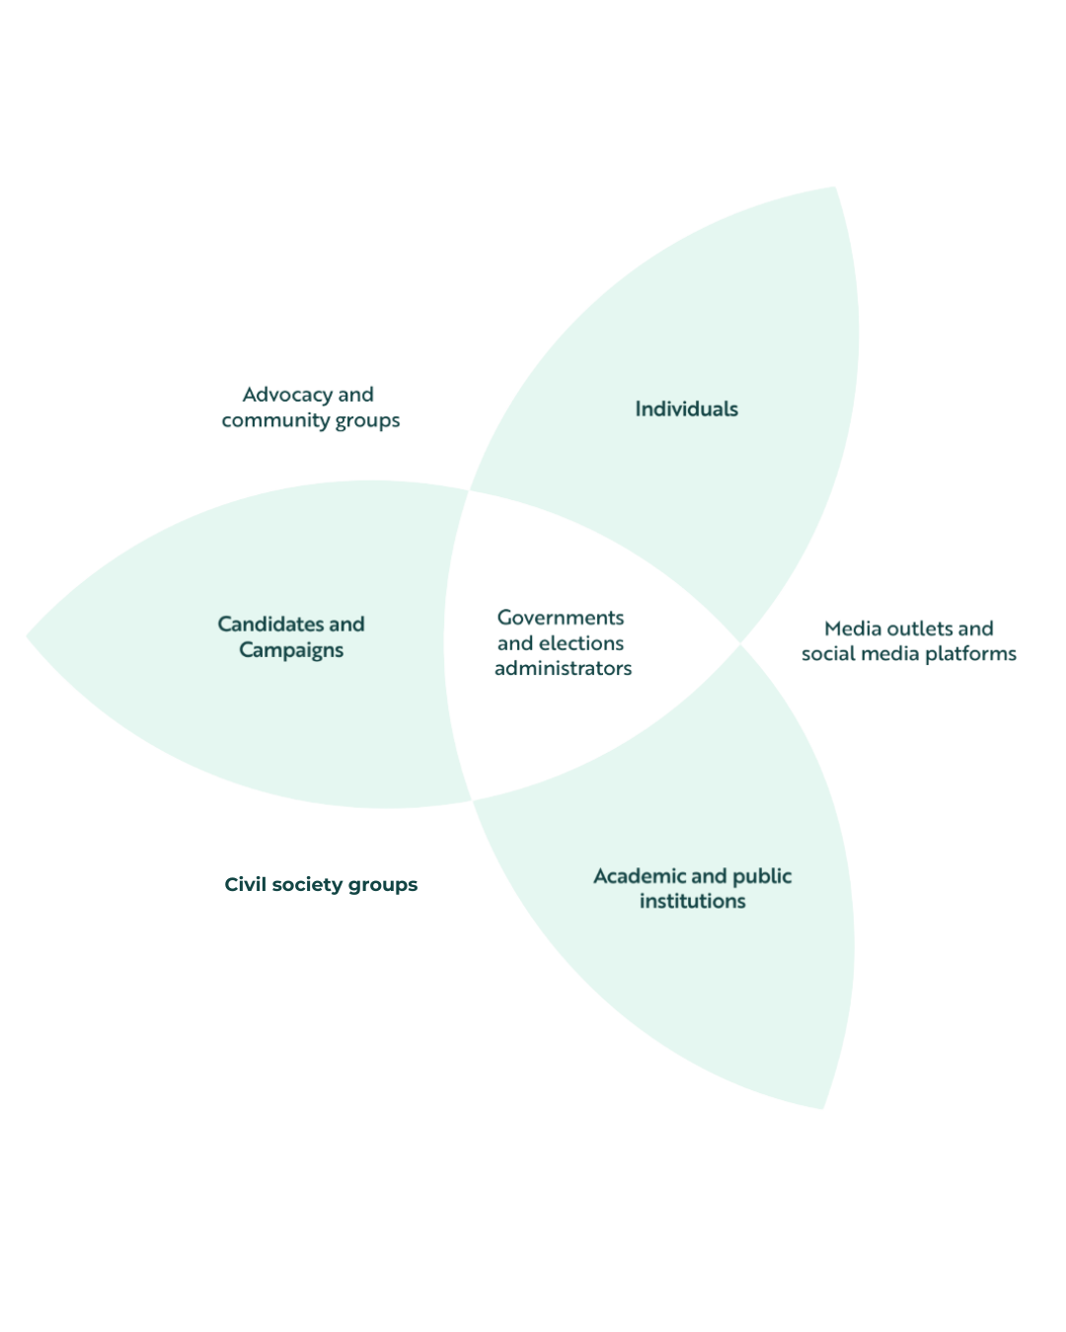
We All Have a Role to Play
Notes:
Nearly two-thirds of eligible voters are not participating: who are they and how do we reach them?
The challenge of voter engagement requires a whole-of-society response.

Slide 13
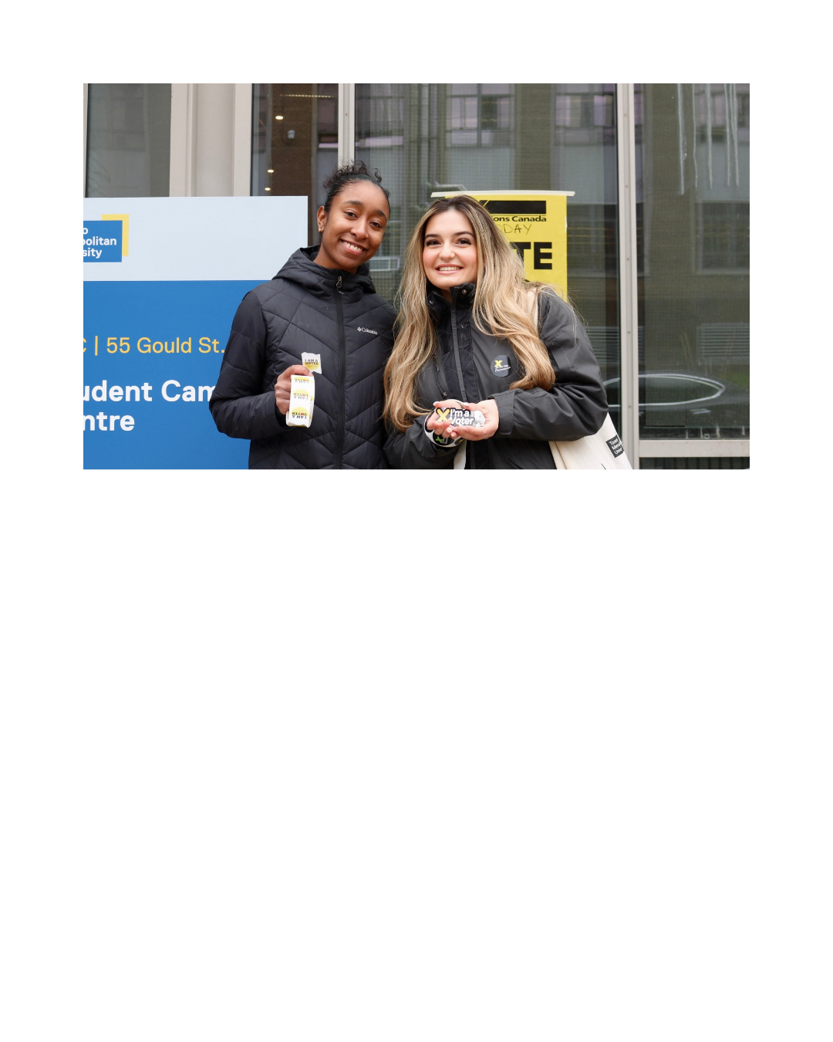
The Role of Voter Education
Notes:
While barriers to voting have been reduced through hard work and investments, many first-time and infrequent voters assume that voting is harder than it is.
In federal election studies, first-time voters predicted it would take twice as long as it actually did. They predicted it would take 39 minutes, and it actually took only 18 minutes. And that includes travel time.
The good news - voting is easy for most people
The challenge - first-time voters think voting is hard
The solution - voter education campaigns that emphasize how easy voting is for most people.
Transition: The primary challenge to overcome is voter motivation.

Slide 14
What Motivates
People to Vote
Notes:
One way to approach voter motivation is to strengthen beliefs, trust, and norms.
I suspect that most people in the room grew up with these: A sense of civic duty, An interest in politics, Trust in the political system, A desire to change policy. Alignment with community norms that encourage participation
When we meet people where they are at, their pre-existing beliefs and attitudes, it’s a stronger foundation for this work.
Important to mention that political candidates, campaigns, and contexts can shape how a person responds to politics on a race-by-race basis. Equally important to understand the strategies that strengthen campaigns and candidates.

Slide 15
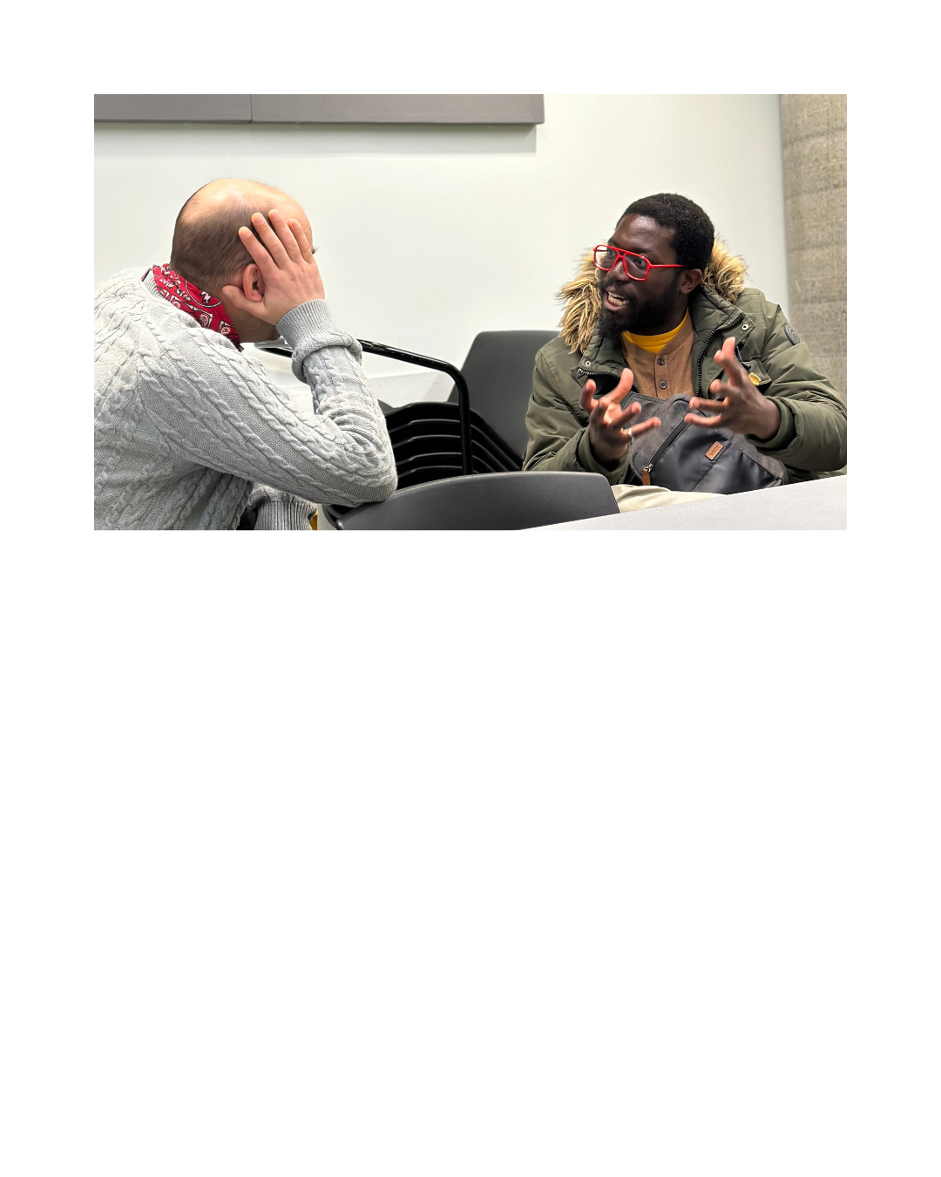
Principle 1:
Begin by Listening
Notes:
Will speak to two principles that underpin this work:
Build campaigns that listen first. When you listen, you demonstrate respect, build trust, and most importantly remind people that their voice matters.
Motivation begins with understanding people’s lived experiences (their stories, histories, and relationships with power). Voting is not just a rational act but an emotional and social one, shaped by community norms, identity, and trust.
Listening can take many forms including as community forums, and storytelling platforms that elevate resident voices. Part of listening is “joining their table” and not just asking them to join yours. That means going into community and on the flipside, means community organizations opening up their tables
Tell the story of Halifax Public Library.

Slide 16
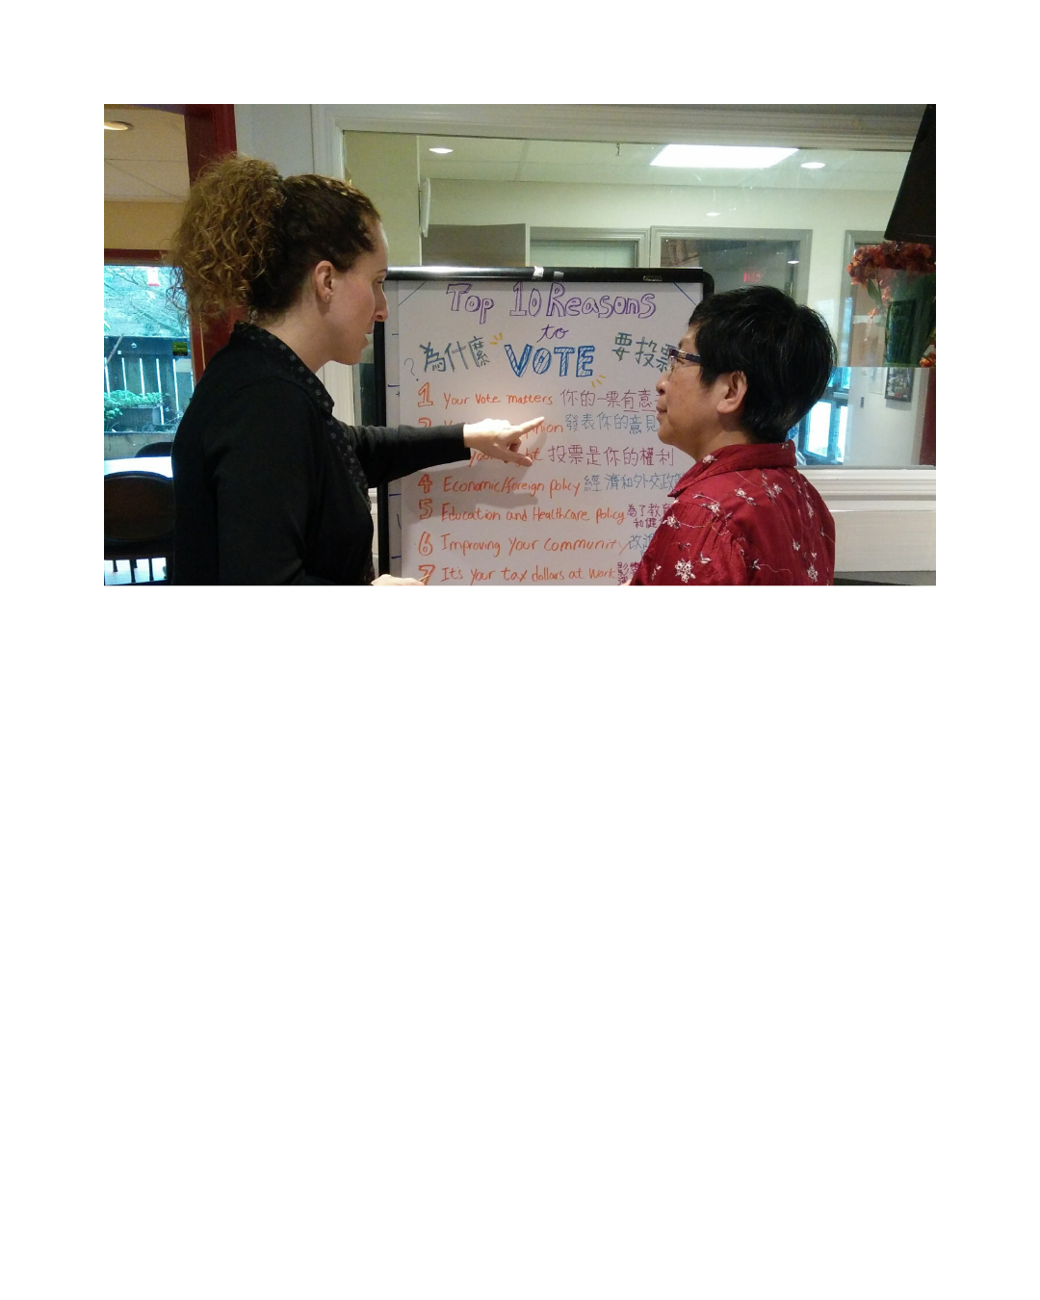
Principle 2:
Strengthen Community
Notes:
A culture of engagement grows when people have trusted spaces to be seen, to share stories, and to connect their personal experiences to collective change. Invest in relationships to build and strengthen community:
Invest in local leaders who mobilize their own communities.
Create spaces for dialogue that connect civic learning to personal experience.
Make engagement continuous, not just election-season work.
Voting becomes meaningful when people see themselves as part of a shared project.

Slide 17
Strategy 1:
Community-Based Initiatives
Community-based organizations are our trusted partners in community outreach during and around elections.
Notes:
Community-based organizations are the glue that binds us together. These are our libraries, community centres, food centres, settlement agencies, youth and seniors programs. We need to invest in them and partner with them.
Build relationships and support civil society as non-partisan partners. They are our trusted partners in community outreach and engagement during and around elections.
Community-based initiatives can build a culture of participation for the public. These efforts include supporting diverse local media, empowering groups that represent marginalized communities, and making government easier to access so people feel involved in policy decisions rather than just affected by them

Slide 18
Strategy 2:
Policies Encouraging Civic Engagement
Create opportunities for people to meaningfully participate in decision-making between elections.
Notes:
Policies encouraging participation in decision-making between elections are an important way to ensure people are comfortable with and have trust in local government, and feel ready and excited to vote come election time.
These policies can include participatory budgeting, “coffee with the councillor” programs, and youth and/or community-based councils.

Slide 19
Strategy 3:
Candidate Forums and Debates
Engage trusted partners to host, facilitate, and promote candidate forums and debates.
Notes:
Candidate forums and debates are spaces for people to hear from candidates and ask them questions. These forums increase voters’ understanding of complex issues and policies, while also connecting the community to the electoral process.
Community-based organizations and municipalities can facilitate and promote engaging forums.
Think about meeting people where they are at, from grocery stores to community centres.
Note, issues around civility make these more fraught.

Slide 20
Strategy 4:
Enhance Access to Candidates’ Experience and Policies
From non-partisan guides to local and new media, there are many ways to enhance access to candidates’ experience and policies.
Notes:
Beyond candidate forums, many ways to enhance access to candidates’ experience and policies. Meet people where they are at!
Municipalities can create and provide non-partisan guides with trusted information about local candidates.
Candidates can engage with local media and seek opportunities to engage with new media (independent journalistic voices) in ways that are exciting/creative.

Slide 21
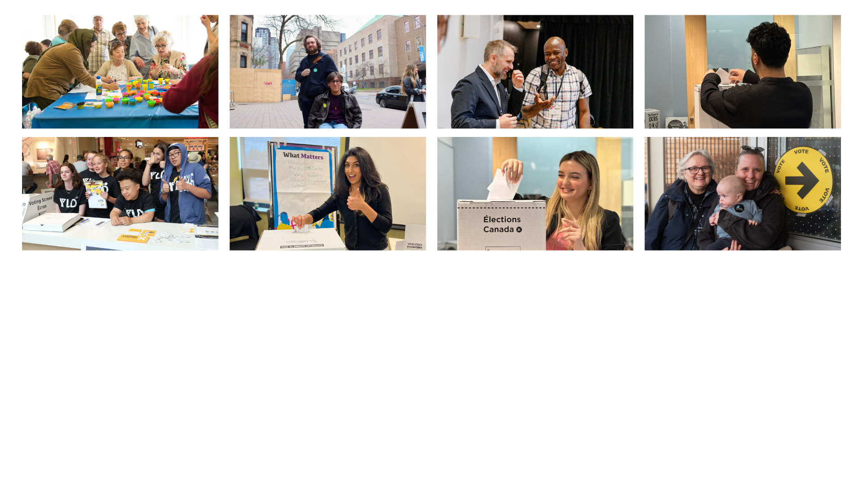
A Year of Engagement
Notes:
The next municipal cycle must begin now with an investment that creates a culture of engagement and the democratic infrastructure that supports it.
Time for Q&A!

