Slide 1
Launching
AMO’s Local Democracy Solutions Bank 2.0

Slide 2
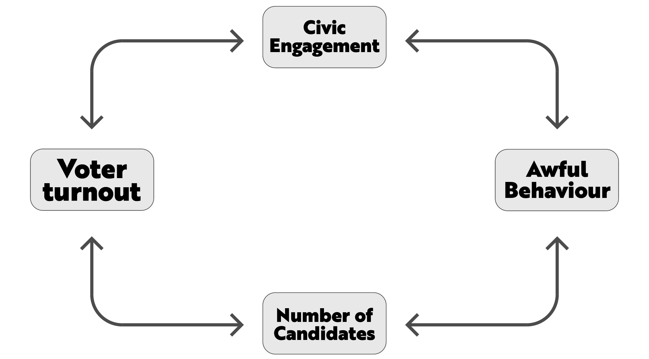
Remember the crowded intersection

Slide 3
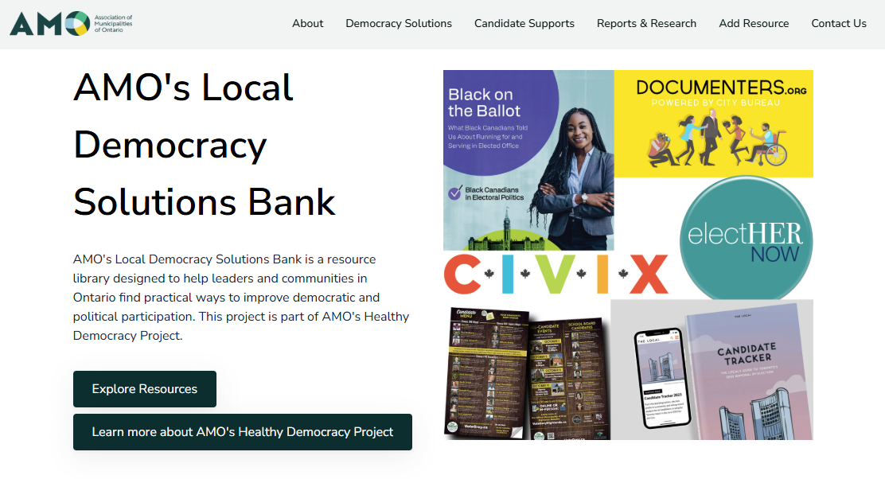

Slide 4
Seven ways we can improve local democracy
Supporting candidates and newly elected officials
Improving electoral participation
Encouraging democratic participation
Countering misinformation and supporting local media
Engaging diverse communities
Improving civic education
Fostering civility and respect

Slide 5
Solution partners
Solution type
Solution level
Governments
Non-profits, charities, or community-based organizations
Academic institutions
Resident-led community-groups
Elected officials, candidates, and campaigns
Media institutions
Meetings, activities, and training
Reports and recommendations
Organizations, committees, and positions
Funding
Resources and information
Policies and initiatives
National, sub-national, and/or local
Country of origin
Province
Municipality
Municipality size, form, and tier
Municipal population
How long solution has been in use
How long the solution takes to enact
Which specific organizations are involved
What are the stats and analytics on the solution
Where did funding for the solution come from

Slide 6
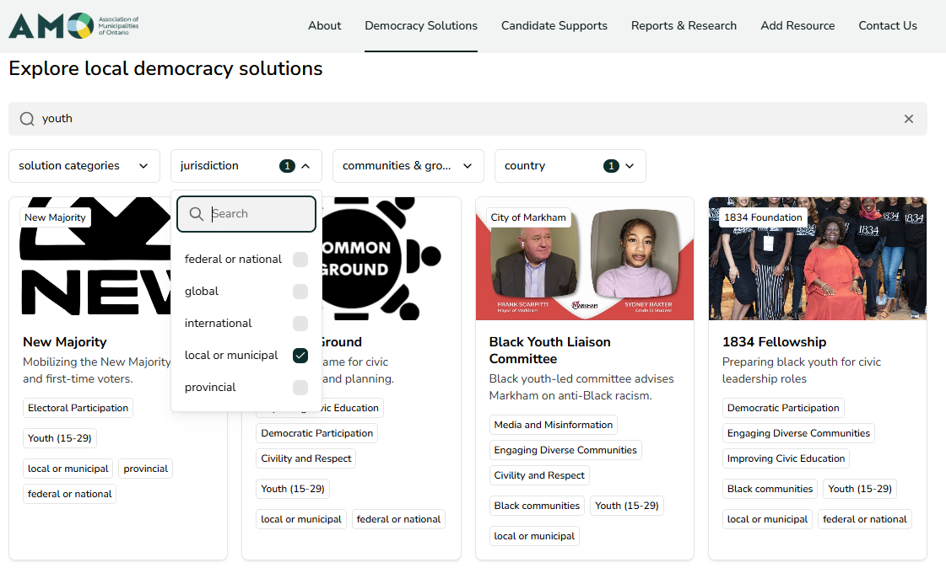
How it works

Slide 7
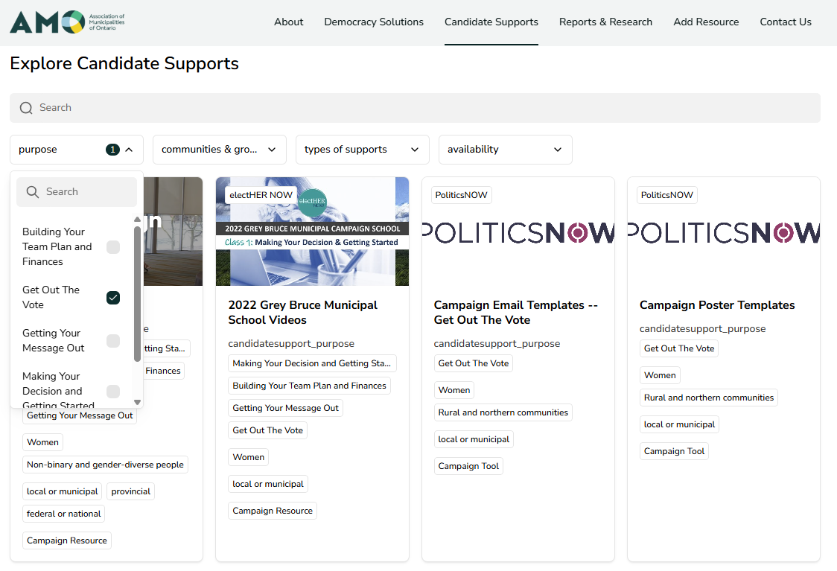
What’s new?

Slide 8

Types of candidate supports
Building your team plan and finances
Get out the vote
Getting your message out
Making your decision and getting started

Slide 9
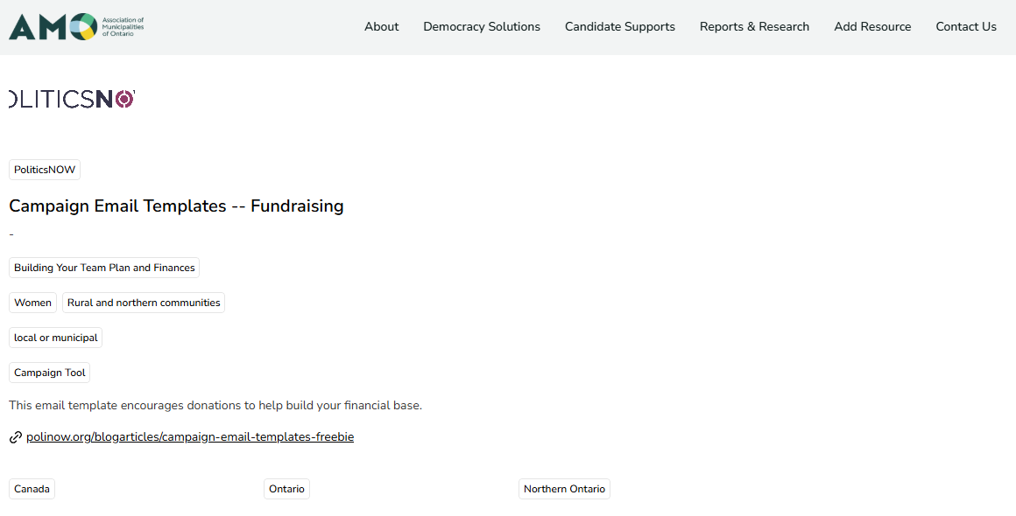
What’s new?

Slide 10
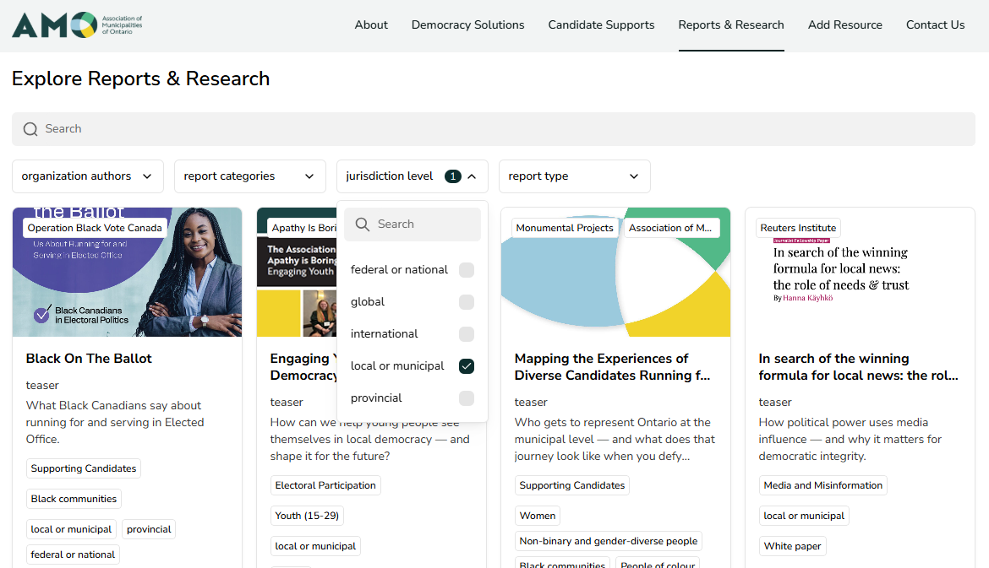
What else is new?

Slide 11
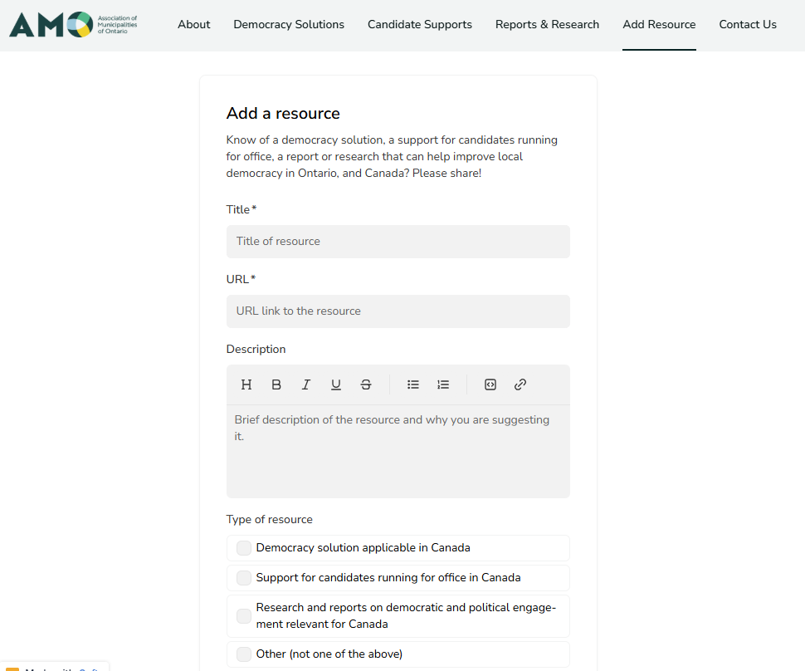
What can you do?

Slide 12
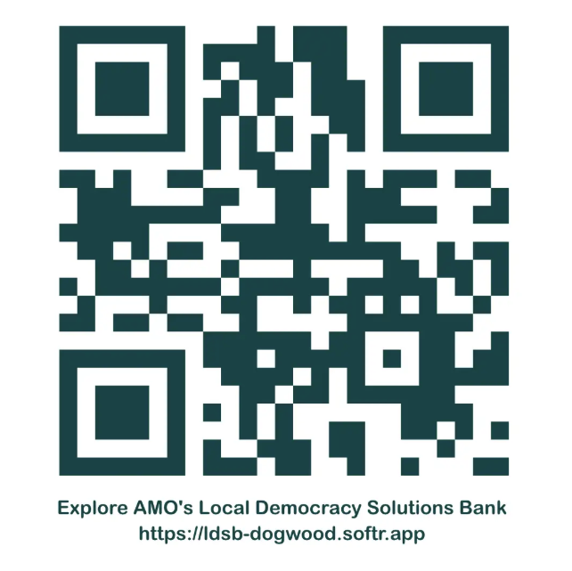

Slide 13

Questions?

