Slide 1

Citizens, governments & democracy: an overview of Canadian public opinion Andrew Parkin Executive Director Environics Institute for Survey Research
AMO's 2nd Annual Healthy Democracy Forum
Toronto
October 19, 2025

Slide 2
Five recent changes in public opinion
Part 1

Slide 3
As the pandemic recedes, our outlook on the economy has steadily worsened
Source: Environics Institute / Survey on Employment and Skills

Slide 4
A cascade of new problems to worry about In your opinion, what is the most important problem facing Canadians today?
1980s
1990s
2000s
2010s
2020s
1983
2025
Source: Environics Institute / Focus Canada

Slide 5
A sudden increase in concern about immigration levels after 2022
Source: Environics Institute / Focus Canada

Slide 6
Rethinking our relationship with our “closest ally”
Source: Environics Institute / Focus Canada

Slide 7
And other changes in attitudes are unfolding “beneath the surface”
Source: Environics Institute / AmericasBarometer

Slide 8
Canadians and democracy
Part 2

Slide 9
Satisfaction with the way democracy works in Canada 2010 - 2025
In general, would you say that you are very satisfied, satisfied, dissatisfied or very dissatisfied with the way democracy works in Canada?
Source: Environics Institute / AmericasBarometer

Slide 10
Agree or disagree: Democracy may have problems, but it is better than any other form of government
Democracy may have problems, but it is better than any other form of government. To what extent do you agree or disagree with this statement?
(Using a scale ranging from 1 to 7, where 1 means “strongly disagree” and 7 means “strongly agree.”)
Source: Environics Institute / AmericasBarometer

Slide 11
Most agree that democracy is preferable to any other form of government (when the alternative is an authoritarian government) – with no change since 2010
Source: Environics Institute / AmericasBarometer

Slide 12
Public support for Canada’s political system is holding steady
(Using a scale ranging from 1 to 7, where 1 means “not at all” and 7 means “a lot.")
Source: Environics Institute / AmericasBarometer

Slide 13
Satisfaction with the way democracy works in Canada 2010 – 2025, Very satisfied or satisfied, by federal party support
In general, would you say that you are very satisfied, satisfied, dissatisfied or very dissatisfied with the way democracy works in Canada?
* Results for the 2010 and 2012 surveys are based on a question about the party you voted for in the most recent election (2008 and 2011 respectively). Results from 2014 onward are based on a question about the party you would vote for if an election were held today. No question on party support was included in the 2017 survey.
Source: Environics Institute / AmericasBarometer

Slide 14
Three statements about democracy 2019 – 2025, by federal party support
Which of the following statements do you agree with the most?
Source: Environics Institute / AmericasBarometer

Slide 15
Respect for election results 2025, by federal vote intention
Election results should be respected regardless of which candidate or party wins. To what extent do you agree or disagree with this statement?
Source: Environics Institute / AmericasBarometer

Slide 16
Trust in institutions
Part 3

Slide 17
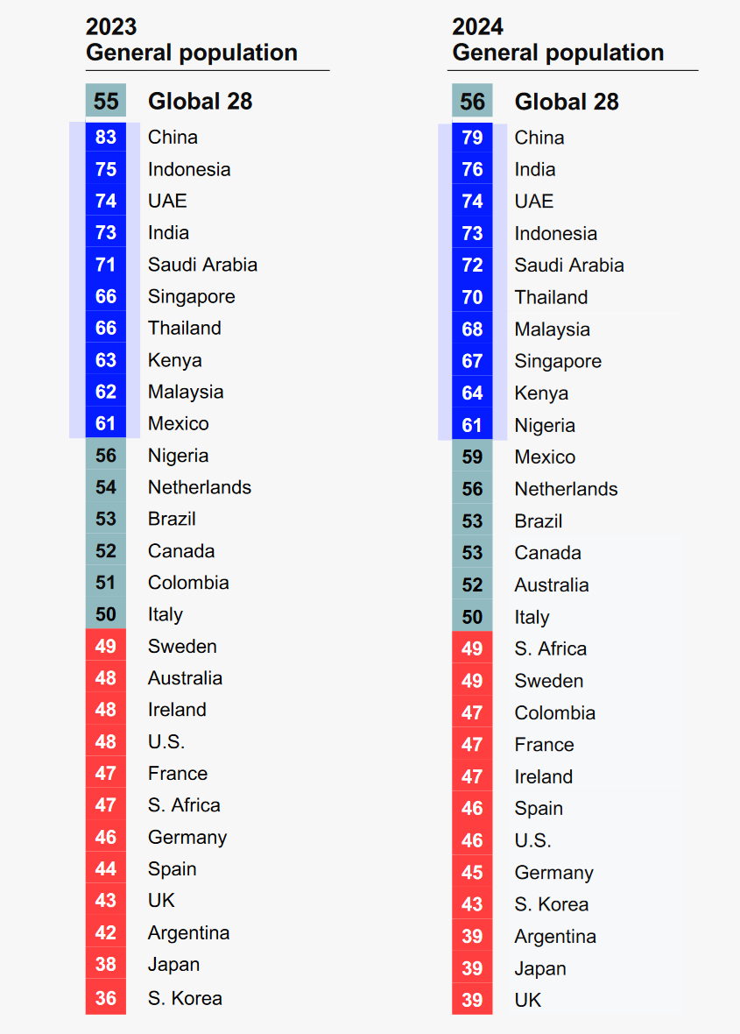
Trust in government: what’s the ideal?
Edelman Trust Barometer (2024)

Slide 18
Trust in Parliament: three different measures
To what extent do you trust Parliament? (Using a scale ranging from 1 to 7, where 1 means “not at all” and 7 means “a lot.")
Source: Environics Institute, AmericasBarometer

Slide 19
The trend: trust in political leaders and institutions
To what extent do you trust …? (Using a scale ranging from 1 to 7, where 1 means “not at all” and 7 means “a lot.")
Source: Environics Institute, AmericasBarometer

Slide 20
Trust in your municipal government: three different measures
To what extent do you trust your municipal government? (Using a scale ranging from 1 to 7, where 1 means “not at all” and 7 means “a lot.")
Source: Environics Institute, AmericasBarometer

Slide 21
Trust in your municipal level (2025): complete responses
To what extent do you trust your municipal government? (Using a scale ranging from 1 to 7, where 1 means “not at all” and 7 means “a lot.")
Source: Environics Institute, AmericasBarometer

Slide 22
Citizens & governments
Part 4

Slide 23
Agree or disagree: Those who govern this country are interested in what people like you think
Those who govern this country are interested in what people like you think. To what extent do you agree or disagree with this statement?
(Using a scale ranging from 1 to 7, where 1 means “strongly disagree” and 7 means “strongly agree.”)
Source: Environics Institute / AmericasBarometer

Slide 24
How many politicians in Canada are involved in corruption?
Thinking of politicians in Canada… how many of them do you believe are involved in corruption?
Source: Environics Institute / AmericasBarometer

Slide 25
To what extent do you trust people whose political views are different from yours?
To what extent do you trust your municipal government? (Using a scale ranging from 1 to 7, where 1 means “not at all” and 7 means “a lot.")
Source: Environics Institute, AmericasBarometer

Slide 26
To what extent do you trust people whose political views are different from yours?
To what extent do you trust your municipal government? (Using a scale ranging from 1 to 7, where 1 means “not at all” and 7 means “a lot.")
Source: Environics Institute, AmericasBarometer

Slide 27
Is this what the “age of populism” looks like in Canada?
Source: Environics Institute / AmericasBarometer

Slide 28
Is this what the “age of populism” looks like in Canada?
Source: Environics Institute / AmericasBarometer

Slide 29
Recap
We have seen dramatic shifts in public opinion on a number of issues in recent years… but attitudes towards our democracy have been comparatively stable
There are certainly gaps between the supporters of the different political parties, but more on the side of satisfaction with what our democracy is delivering than underlying support for democracy itself
Most Canadians tend to have at least some trust in public institutions rather than either high or low trust … and the proportion with “low trust” has not been increasing
Politicians and political parties are less trusted than most other institutions and actors in our democracy … but this is hardly new or worse than before
By almost a 3:1 margin, Canadians favour a style of politics with more compromise rather than less

Slide 30
Andrew Parkin Executive Director andrew.parkin@environics.ca @parkinac
701-33 Bloor Street East, Toronto, ON M4W 3H1
environicsinstitute.org
info@environicsinstitute.org
@Environics_Ins
Thank you!
Substack:
Canadian Survey Stuff
https://cdnsurveystuff.substack.com/

